Slide 1

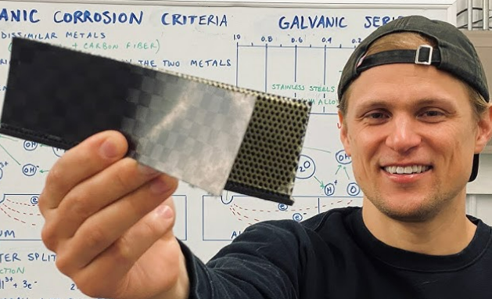
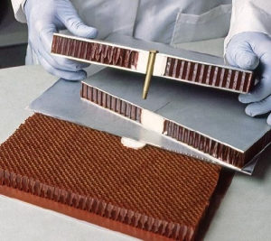
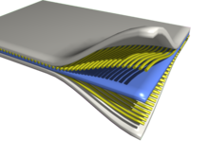
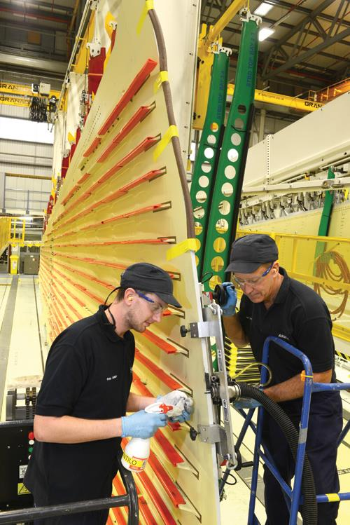
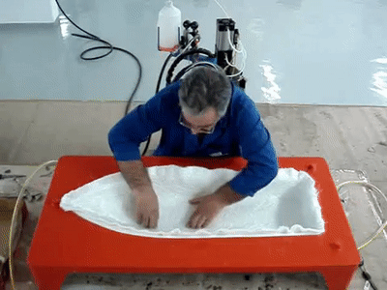
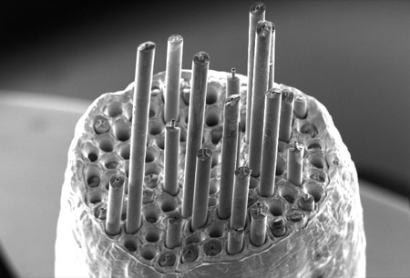
General Information
About Composite Materials
Mehmet Zor
Professor of Mechanical Engineering
Dokuz Eylul University
İzmir - Turkey
Web: mehmetzor.com
mehmet.zor@deu.edu.tr

Slide 2
Contents
What is Composite Material?
Basic Properties of Composite Materials
Application Areas of Composites
Sample Products Containing Composites
Composites and Engineering Activities
Why Composite Material?
History of Composite Materials
Classification of Composite Materials
Disadvantages of Composites
Matrix Materials
Fiber Materials
Manufacturing Technologies in Composites

Slide 3
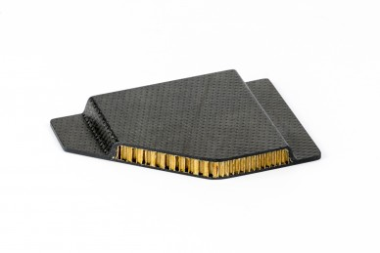
1-What is Composite Material?
A new material created by combining at least two different materials at the macro level (in such a way that they do not dissolve in each other) is called composite material.
The aim is to develop and bring together some features (lightness, strength, flexibility, etc.) that are not available in the components alone.

Slide 4
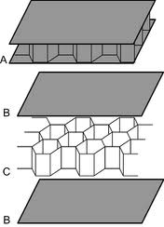
2- Basic Properties of Composite Materials
Although composite actually means mixture, it does not consist of soluble and dissolving components.
There is no exchange of atoms between the components.
Composite components do not chemically affect each other.
If the materials dissolve in each other and there is a mixture at the atomic level, such materials are not composites but alloys.
If the mixture is at the level of nanometer particles, these types of composites are called nano composites.

Slide 5
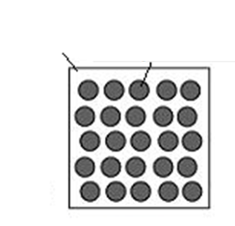
2-Basic Properties of Composite Materials
(continue)
Composites are generally created from a main material called "matrix" and a more durable material called "reinforcement element (fiber)".
Of these two groups of materials, the reinforcement material increases the strength and load-bearing ability of the composite material.
The matrix material plays a role in preventing crack propagation that may occur during the transition to plastic deformation and delays the rupture of the composite material.
reinforcement element (fiber)
matrix

Slide 6

3-Application Areas of Composites

Slide 7
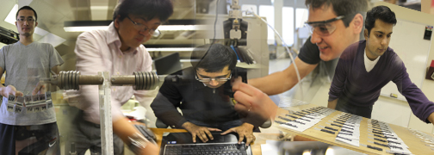
3-Application Areas of Composites
(continue)
With the developments in composite material technology, composites have begun to be used at increasing rates in industrial and technology applications.
Scientific studies on composites, which are used significantly especially in the aircraft industry and many other sectors, continue intensively today.

Slide 8
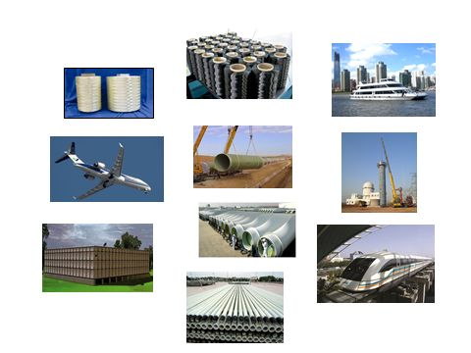
3-Application Areas of Composites
(continue)
Composite materials are used in a wide variety of areas thanks to their structure and properties. Since each sector has different needs and expectations, the product flexibility of composite materials appears as an important advantage.
Composites are used as raw materials in different sectors as well as as auxiliary equipment in manufacturing.
The main sectors where composite materials are widely used and the product types used in these sectors are briefly summarized below:

Slide 9

3-Application Areas of Composites
(continue)
Composites are used in many areas such as
Space technology,
Maritime industry,
Manufacture of medical devices,
robotics technology,
chemical industry,
Electrical-Electronic technology,
musical instruments industry,
Construction and building industry,
Automotive industry,Defense
Industry and Aviation Sector,
Food and Agriculture Sector
Manufacturing of sports equipment (high jump poles, tennis rackets, surfing, racing boats, skis, etc.)

Slide 10
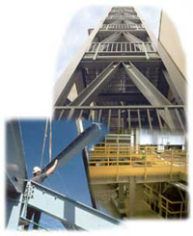
3-Application Areas of Composites
(continue)
3.1 Buliding Sector:
Exterior and interior coverings
Decorative applications
Roofing sheets and roof detail profiles
Carrier profiles
Rainwater transport systems
Various purpose insulation Works
Concrete molds
Prefabricated buildings
Bridges
Water tanks, gratings, underground pipes, food aisle coverings. Observatory Domes, Open Field Cabinets, Bulletin Boards, etc.

Slide 11
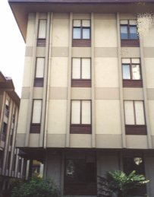
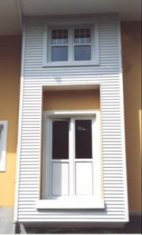
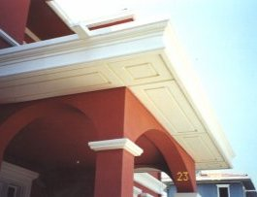
3-Application Areas of Composites
(continue)
3.1 Buliding Sector - (continue):
Window cores made of glass reinforced Polyester (GRP)

Slide 12

3-Application Areas of Composites
(continue)
3.1 Buliding Sector - (continue):
Prefabricated Buildings

Slide 13
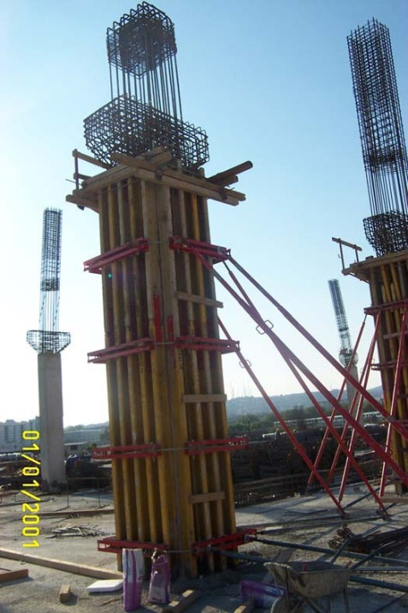
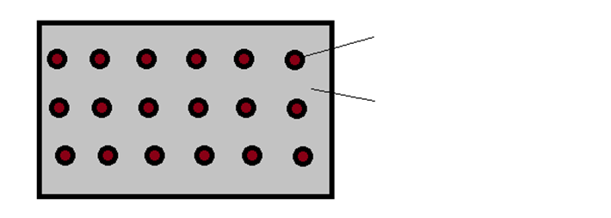
3-Application Areas of Composites
(continue)
3.1 Buliding Sector - (continue):
Concrete columns are created by combining iron and concrete and are actually a composite structure.
iron bar (fiber)
Concrete (matrix)

Slide 14
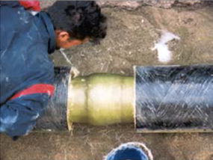
3-Application Areas of Composites
(continue)
3.1 Buliding Sector - (continue):
Cabins
Piping

Slide 15

3-Application Areas of Composites
(continue)
3.2 Automotive and Transportation Sector:
Automobile companies produce light automobiles in order to meet the needs of their customers and increase their competitiveness. Lightweight automobiles are very important in terms of mechanical (acceleration and braking) as well as energy saving.

Slide 16
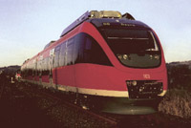
3-Application Areas of Composites
(continue)
3.2 Automotive and Transportation Sector -(continue):
Automobile bodies,
Truck and bus side panels,
Truck trailer side slats,
Truck spoilers and front panels,
Container manufacturing,
Highway signs,Highway side pillars etc...

Slide 17
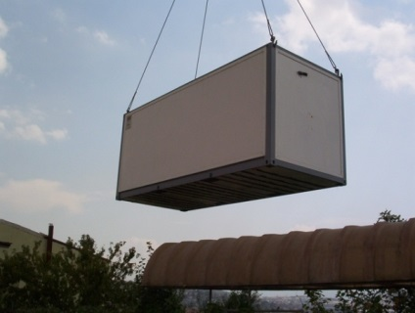
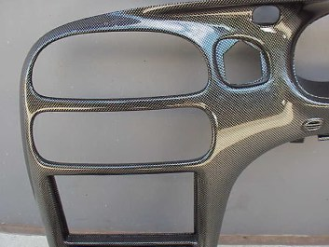
3-Application Areas of Composites
(continue)
3.2 Automotive and Transportation Sector -(continue):
Windshield Wiper; 30% Glass+PBT,
Filter Box; Mercedes, 35% Glass+Polyamide 66,
Pedals; 40% Glass+Polyamide 6,
Rearview Mirror; 30% Glass+ABS,
Headlight Body; BMW, 30% Glass+PBT,
Air Intake Manifold; BMW, Ford, Mercedes, 30% Glass+Polyamide 6,
Automobile Instrument Panel; CTP, GMT
Automobile Spoiler; CTP
Automobile Side Body Skeleton; Ford, CTP
Automobile body; Corvette, SMC GRP
Container manufacturing
GM car dashboard

Slide 18
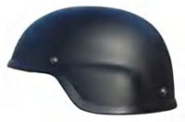
3-Application Areas of Composites
(continue)
3.3 Defense Industry Applications:
Aircraft and helicopter body parts,
Aircraft nose and wing parts,
Mortar bodies and chests,
Bulletproof panel manufacturing,helmets,
Mine and assault boat parts and hulls,Shelters etc...

Slide 19
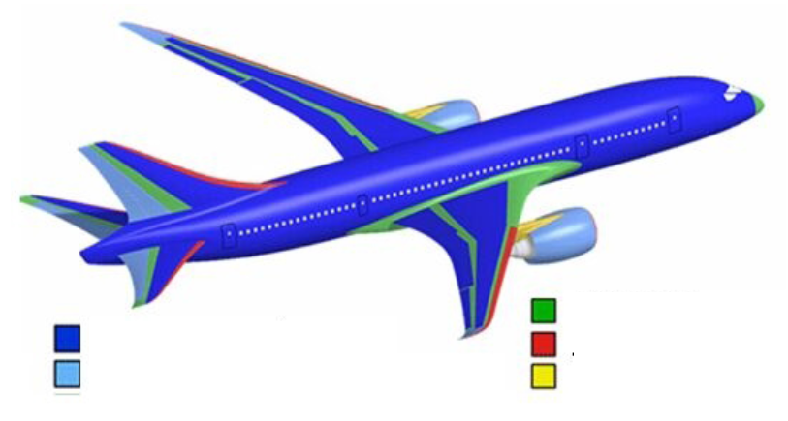
3-Application Areas of Composites
(continue)
3.4 Aviation Industry Applications :
Glass fiber
Carbon composite sheet
Aluminium
Carbon honeycomb structure
Steel & Titanium

Slide 20

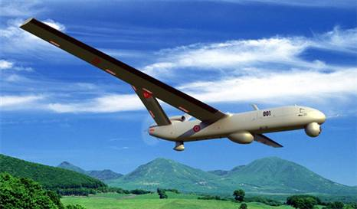
3-Application Areas of Composites
(continue)
3.4 Aviation Industry Applications (continue):

Slide 21
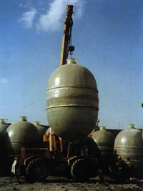
3-Application Areas of Composites
(continue)
3.5 Food and Agriculture Sector Applications
Silos
Food storage tanks
Brine tanks
Aquaculture equipment
Greenhouses
Grain warehouses
Irrigation channels etc...

Slide 22
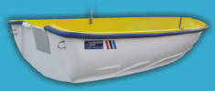
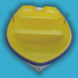
3-Application Areas of Composites
(continue)
3.6 Maritime Industry Applications:
Sailing/motor boats,
lifeboats,
buoys,
canoes,
Pontoons-piers,
marinemotorcycle,
Surfboard,
Marina equipment etc...

Slide 23
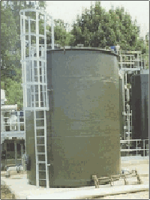
3-Application Areas of Composites
(continue)
3.7 Chemical Industry Applications:
Pipes and fittings for various purposes,
Chemical plant floor grids,
Acid tanks and coatings,
Anodized and galvano tanks,
Purification equipment,
Industrial platforms and railings,
Absorber and Scrubber (gas washing columns),
Ventilation ducts etc...

Slide 24
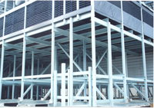
3-Application Areas of Composites
(continue)
3.8 Energy Sector Applications:
insulators,
antennas,
circuit breakers,
Fuse-panel boxes,
lighting bodies,
insulated platforms,
Electricity and lighting poles,
circuit breaker boxes,
Cable carriers,
cable channels,
Ladders, ballasts, etc.

Slide 25
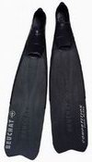
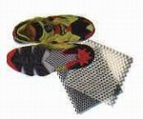
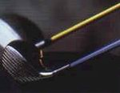


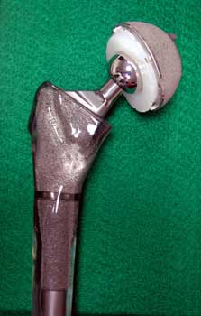
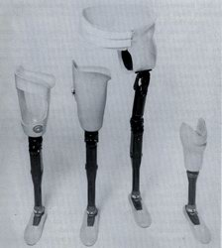
4- Sample Products Containing Composites

Slide 26
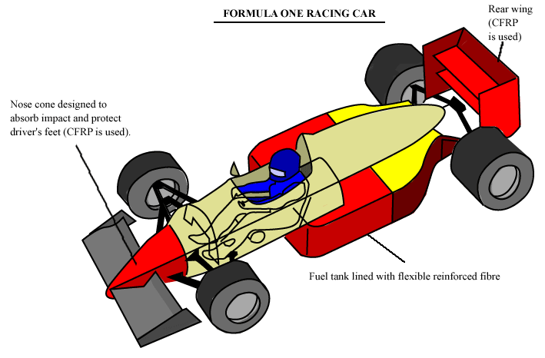
4-Sample Products Containing Composites
(continue)

Slide 27
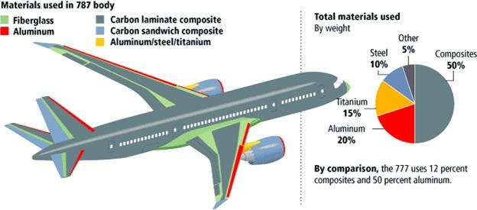
4-Sample Products Containing Composites
(continue)

Slide 28
5- Composites and Engineering Activities
As can be seen, composite materials can be used in many different sectors, they are constantly being developed and their usage rate is increasing day by day.
The probability of encountering composites in any business is quite high.
R&D activities for composite materials are frequently carried out not only in composite producing companies, but also in other companies depending on the usage situation.
In these activities, solutions and development alternatives with composite materials are possible.
For this reason, it is an important privilege and reason for preference for engineers to be able to carry out activities such as design, analysis, theoretical calculations, experimental measurements, developments and manufacturing for composite materials that they can do for isotropic (metal, ceramic, etc.) materials. This is only possible with a good basic knowledge of composite material mechanics.

Slide 29

5- Composites and Engineering Activities
(continue)
The fact that the mechanical behavior of composites is different from isotropic materials and can vary depending on the direction requires that they be examined with different mechanical approaches and criteria.
Sir, let's make the shaft material composite. Let's look at von-mises stresses again.
If we make the shaft composite, it would be more accurate to evaluate it according to the Tsai-Hill criterion, not Von-Mises. Yield-fracture criteria for composites are different.

Slide 30
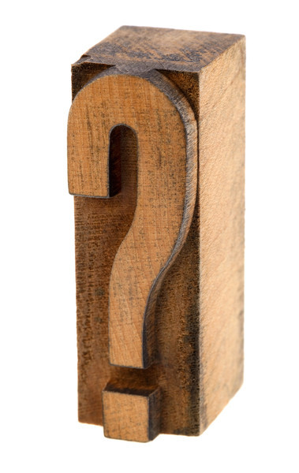
6- Why Composite Material?
There is more than one answer to this question.
Composite materials, which have many advantages over other materials with their characteristic features, are preferred due to their many superior properties such as long life, lightness, high chemical and mechanical resistance.

Slide 31
6- Why Composite Material?
(continue)
The production of composite materials aims to improve one or more of the following properties:
-Strength -Electrical conductivity
-Fatigue strength -Acoustic conductivity
-Wear resistance -Rigidity
-Corrosion resistance –Lightness
-Fracture toughness –Economy
-Thermal properties -Aesthetics
-Thermal conductivity

Slide 32
6- Why Composite Material?
(continue)
When the material properties in the table below are examined, it is seen that composite structures are both much lighter and much more durable than classical metals.
Materials | Density ρ (gr/cm³) | Tensile Strength σ_{ç} (MPa) | Modulus of Elasticiy GPa | Specific Tensile Strength σ_{ç} / ρ | Specific Modulus of Elasticity E/ρ
Non – Alloy Steel | 7.9 | 459 | 203 | 58 | 26
Alüminium | 2.8 | 84 | 71 | 30 | 25
Aluminium Alloy -2024 | 2.8 | 247 | 69 | 88 | 25
Brass | 8.5 | 320 | 97 | 38 | 11
Wooden (Beech) | 0.7 | 110 | 13 | 157 | 19
Bone | 1.8 | 138 | 26 | 75 | 14
Boron epoxy | 1.8 | 1600 | 224 | 889 | 124
Carbon-Epoxy-1 | 1.6 | 1260 | 218 | 788 | 136
Carbon-Epoxy-2 | 1.5 | 1650 | 140 | 1100 | 93
Kevlar-Epoxy | 1.4 | 1400 | 77 | 1000 | 55
S Glass-Epoxy | 1.8 | 1400 | 56 | 824 | 33
E Glass-Epoxy | 1.8 | 1150 | 42 | 639 | 23

Slide 33
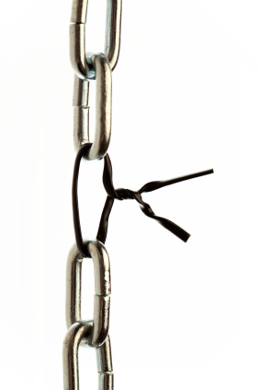
6- Why Composite Material?
(continue)
6.1 High Specific Strength (strength/density ratio)
Composites with much higher strength values than those of classical metallic materials can be produced. Since their density is lower, the specific strength of the composites will be higher. For example: Composite profiles with high mechanical properties can be produced and used in constructions.

Slide 34
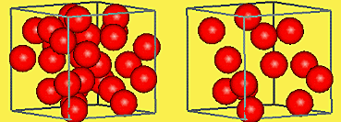
6- Why Composite Material?
(continue)
6.2 High stiffness/density ratio (Specific Rigidity):
Composites with high stiffness/density ratios can be produced, which provides a significant advantage over classical materials.

Slide 35
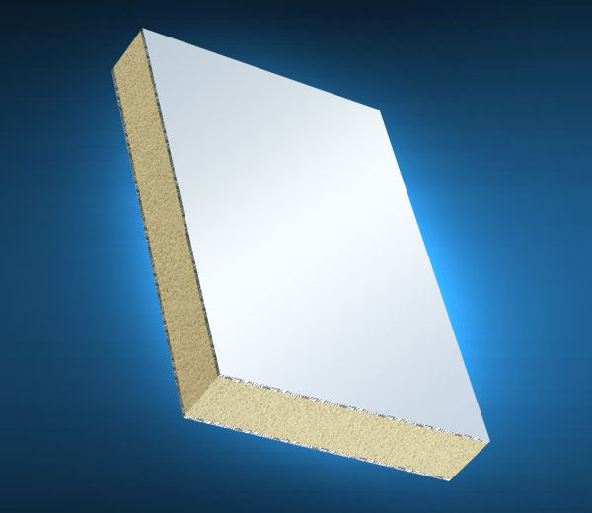
6- Why Composite Material?
(continue)
6.3 Lightness: Plastic-based composites are both lighter and have higher strength values than traditional materials. A profile section produced from composite material weighs approximately 1/4 of an equivalent steel profile.

Slide 36
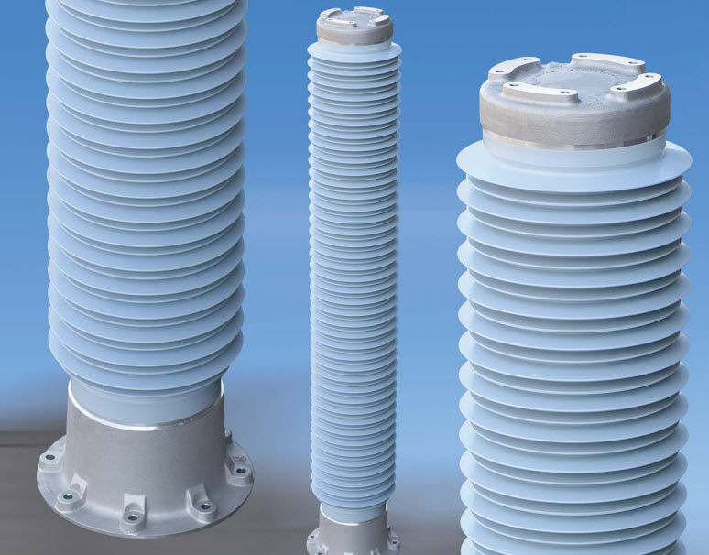
6- Why Composite Material?
(continue)
6.4 High Dielectric Resistance:
The high electrical insulation properties of composites make them preferred in the manufacturing of many machine elements.They are also widely used in the electrical and electronics industry.Example: They are widely used in the production of elements such as transformers, cables and plates.

Slide 37
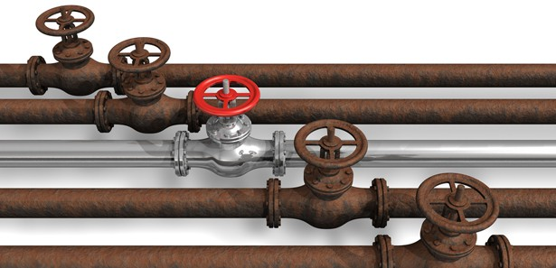
6- Why Composite Material?
(continue)
6.5 Corrosion Resistance:
The anticorrosive properties of composites against environmental conditions are far superior to other materials.
Thanks to their high chemical resistance ability, composite materials are widely used in chemical plants and other areas at risk of chemical corrosion.
They are used in many areas, from chemical storage tanks to platforms and walkways.

Slide 38
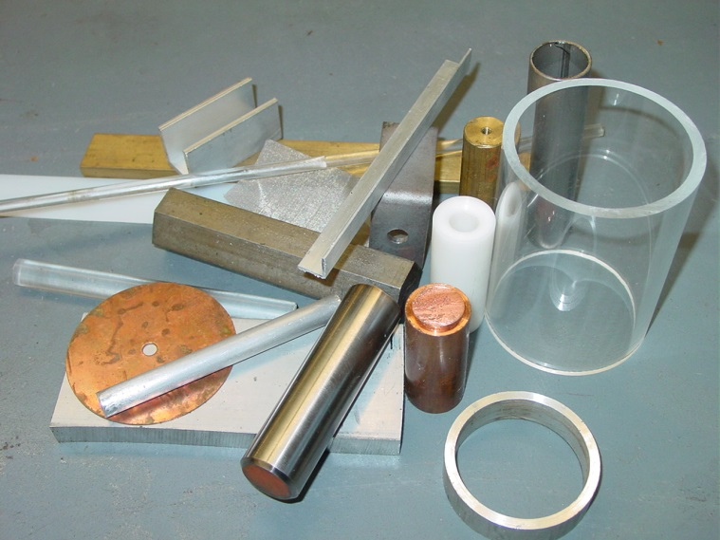
6- Why Composite Material?
(continue)
6.6 Diversity: Composite materials with different combinations with different mechanical properties can be manufactured.

Slide 39
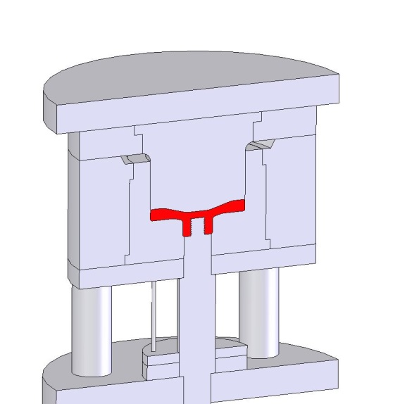
6- Why Composite Material?
(continue)
6.7- Ease of Molding:
Complex machine elements consisting of multiple parts can be manufactured as a single piece using composites.
In this way, since the number of parts will decrease, the production time is shortened as the interconnecting details and parts decrease.
However, it is very difficult to achieve this situation in traditional materials such as aluminum and steel.

Slide 40
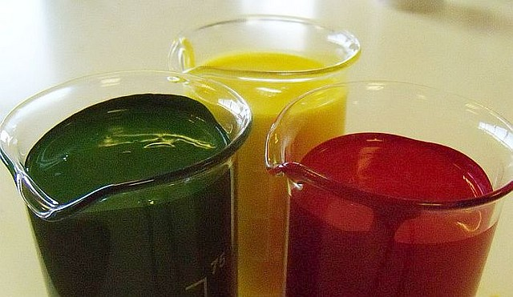
6- Why Composite Material?
(continue)
6.8. Color variety:
The polyester resin used in composites can be colored with special pigment additives and produced as self-colored according to the purpose.

Slide 41
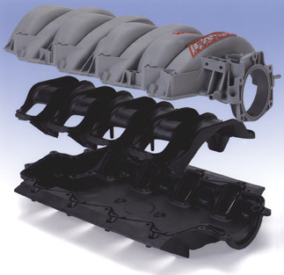
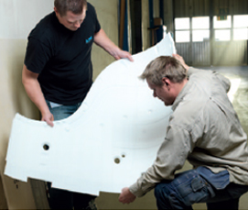
6- Why Composite Material?
(continue)
6.9 Ease of design:
Even complex machine elements can be easily designed with composite materials.

Slide 42
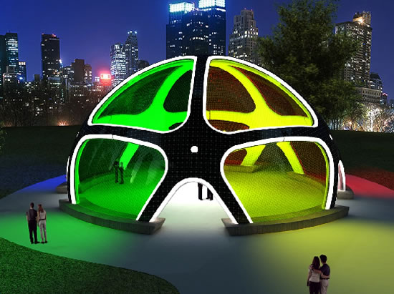
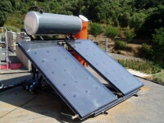
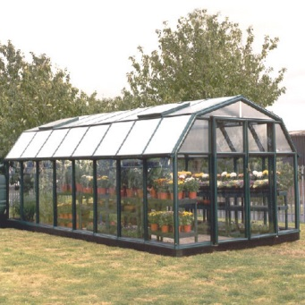
6- Why Composite Material?
(continue)
6.10 Transparency Feature:
Composites can be as light-permeable as glass.
Due to their transparency, they are used in greenhouses and solar collector manufacturing where light transmittance is important.
This multi-colored solar powered dome can be fitted with varied colored transparent composite material.

Slide 43

6- Why Composite Material?
(continue)
6.11 Applicability to concrete surfaces:
Since concrete is porous, good adhesion is achieved due to the infiltration of polyester, one of the main components of the composite, into the pores of the concrete.
GRP polyester roof insulation

Slide 44

6- Why Composite Material?
(continue)
6.12 Applicability to wooden surfaces:
Composites are used as protectors and coatings on wooden surfaces. However, if the wood is dry, good adhesion must be achieved by adding polyester resin.

Slide 45

6- Why Composite Material?
(continue)
6.13 Applicability to metal surfaces
After cleaning the rust and oil residues on the metal surface, it can be coated with composites.
In this way, iron and steel surfaces can be protected from corrosion.

Slide 46

6- Why Composite Material?
(continue)
6.14 Fireproof Feature:
Flame resistance of composites depends on the properties of the polyester used.
Depending on the properties of the composite components, their resistance to burning can be increased.
Since their heat conduction is low, they are used as insulation materials.
Flame resistance can be improved with chemical additives.
Composite materials, which have flame retardant, non-spreading and self-extinguishing properties, have a minimum level of toxic gas released during a fire.
With these features, they are used at critical safety points such as fire escapes.

Slide 47

6- Why Composite Material?
(continue)
6.15 Thermal Resistance :
ALUMİNE FIRE APPROACH AND ENTRANCE DRESS
In particular, polyester resin-based composites from the thermoset plastic group do not change shape by softening. Thermal resistance depends on the type of polyester resin used.
Glass fiber, KEVLAR:
It is produced by coating a high temperature resistant aluminized polyester film on one side of the PBI / KEVLAR or Preox fabric under vacuum. Due to this special manufacturing technique, it does not crack or break, and is resistant to acid, base, salt and petroleum products. It protects firefighters by reflecting back 95% of the heat reflected from a 1000˚C heat source, depending on the type of fabric..

Slide 48

6- Why Composite Material?
(continue)
6.16 Repairability:
Composites can be repaired if damaged. A mold is used in the repair process. After the repair, sanding and painting are done.

Slide 49
6- Why Composite Material?
(continue)
6.17 Processability:
Composites are easily cut, drilled and sanded. Better results can be obtained if the tools used for this purpose are hard steel or diamond tipped.

Slide 50

6- Why Composite Material?
(continue)
6.18 Wide color and pattern options,
6.19 Flexibility,
6.20 Sealing (water insulation),
6.21 U.V. resistance to rays,
6.22 Ease of assembly

Slide 51

7- History of Composite Materials
Since ancient times, human beings have tried to eliminate the fragility of fragile materials by putting plant or animal fibers into them.
The best example in this regard is adobe.
Fibers such as handle, straw and ivy branches added to the clay mud in adobe production increase the strength of adobe.

Slide 52

7- History of Composite Materials
(continue)
Arrow bows made by stacking wooden boards with different properties and fiber directions on top of each other can be given as another example.

Slide 53

7- History of Composite Materials
(continue)
There are patents taken in the early 19th century about the production method of artificial stone slabs using hydraulic binders and fiber materials.
Cement and asbestos composites, which were first used to make thin sheets, have been used for years and are still used today.

Slide 54

7- History of Composite Materials
(continue)
On the other hand, it is understood from research that the application of fibers, which are widely used in reinforcing composites today, is not very new. For example, the production of glass fibers dates back to ancient Egypt.
Moreover, various items made of glass fibers of different colors from the XVIII Dynasty indicate that the manufacture of fine glass fibers was made in Ancient Egypt around 1600 BC.

Slide 55

7- History of Composite Materials
(continue)
The first record of the use of glass fibers in industry is dated 1877.
Synthetic resins reinforced with fibers have been used in industry since the 1950s.
The most well-known group of this material is "glass fiber reinforced polyester (GRP)".

Slide 56

7- History of Composite Materials
(continue)
These materials, known as "fiber-glass" in our country (Turkiye), have been used in the manufacture of elements such as liquid tanks, roof sheets, and small-sized sea boats since the 1960s.
The bodywork of "Anadol", the first mass-produced domestic car in Turkiye, is also made of this material.

Slide 57

7- History of Composite Materials
(continue)
Today, many different composite materials and products have been developed in many sectors such as aviation, shipping and energy.

Slide 58
7- History of Composite Materials
(continue)
Some promotional videos about composite materials:
http://wwwhttps://www.youtube.com/watch?v=0
https://www.youtube.com/watch?v=04K0bLwCDdM
https://www.youtube.com/watch?v=n3bWw8A2xwI

Slide 59

8- Classification of Composite Materials
The options for creating composite materials are almost endless. Therefore, they are very difficult to classify. However, common classifications will be emphasized here.

Slide 60

8- Classification of Composite Materials
8.1 According to Matrix Material Type:

Slide 61

8- Classification of Composite Materials
(8.1 According to Matrix Material Type)
8.1.1 Metal Matrix Composites (MMC):
These materials are composites in which the main structure consists of matrix metal and a ceramic reinforcement phase is generally used as the reinforcement element.
There are almost no limitations in the choice of these materials.
When looking at experimental studies, it is evident that many different species are used.A lot of research has been done on MMCs in the last 45-50 years and their properties have been mentioned positively in the literature.

Slide 62

8- Classification of Composite Materials
(8.1 According to Matrix Material Type)
8.1.1 Metal Matrix Composites (MMC): (continue)
Metal matrix composites are the biggest alternative to traditional materials.
By combining the high elastic modulus of ceramics with the plastic deformation properties of metals, materials that are resistant to wear, have high fracture toughness and compressive stress are obtained.
These composites are widely used in the automotive, aerospace and defense industries.

Slide 63

8- Classification of Composite Materials
(8.1 According to Matrix Material Type)
8.1.2 Ceramic matrix composites (CMC):
Ceramic materials are very hard and brittle.
They also have high temperature resistance and relatively low density properties.
Ceramics are materials with low thermal shock resistance and toughness. As examples of these; Al2O3, SiC, Si3N4, B4C, cBN, TiC, TiB, TiN and AIN can be given.
These compounds have different structures and ceramic matrix composites are obtained by using one or more of them depending on the purpose. Sandwich armor, manufacturing of various military parts and spacecraft are the main uses of these products.

Slide 64

8- Classification of Composite Materials
(8.1 According to Matrix Material Type)
8.1.2 Ceramic matrix composites (CMC) -continue:
Carbon, ceramic and glass fibers added to the ceramic matrix are developed especially for special conditions such as high temperature applications.
If ceramic materials are reinforced with ceramic fibers, composites with higher strength and toughness values are obtained.
Recent studies on alumina and zirconia-based ceramic composites have led to the use of these materials as biomaterials in the human body.

Slide 65

8- Classification of Composite Materials
(8.1 According to Matrix Material Type)
8.1.3 Polimer matrix composites (PMC):
The most commonly used methods in the production of PMCs are hand lay-up, wet filament winding, moulding, pultrusion method, injection molding, extrusion methods.
PMCs are widely used in marine applications due to their corrosion resistance, in the automotive industry, other transportation industries and sports equipment manufacturing due to their lightness, and in automotive interior decorations due to their fireproof properties.

Slide 66

8- Classification of Composite Materials
(8.1 According to Matrix Material Type)
8.1.3 Polimer matrix composites (PMC) -continue:
The most commonly used methods in the production of PMC s are hand lay-up, wet filament winding, moulding, pultrusion method, injection molding, extrusion methods.
PMCs are widely used in marine applications due to their corrosion resistance, in the automotive industry, other transportation industries and sports equipment manufacturing due to their lightness, and in automotive interior decorations due to their fireproof properties.

Slide 67
8- Classification of Composite Materials
8.2 Classification According to Components Pair Alternatives
Matrix Materials | Reinforcement Elements | Shape of Composite Structure
Polymers | Fibers | Layers
Metals | Granular | Coatings
Ceramics | Whiskers | Film-Foil
 | Powder | Honey-Combs
 | Chip | Filament Wrapped Structures
  Granular: Grain-shaped raw material, rice-sized raw product obtained from recycling plastic bags.
  Whiskers: Chopped or ground fiber

Slide 68

8- Classification of Composite Materials
8.3 Classification According to Shape and Placement of Reinforcement Elements :
Monolayer Composites b. Particulate Composites
c. Layered Composites d. Mixed (Hybrid) Composites

Slide 69

8- Classification of Composite Materials
(8.3 According to Shape or Placement of Reinforcement Elements):
8.3.1 Fiber reinforced monolayer composites:
This type of composite consists of a single layer obtained by placing continuous or discontinuous fibers into the matrix structure.
The placement of the fibers is an important factor affecting the strength of the composite structure.
A fiber reinforced composite sheet consists of matrix and reinforcement/fiber components. These components do not dissolve or mix with each other.

Slide 70



8- Classification of Composite Materials
(8.3 According to Shape or Placement of Reinforcement Elements)
8.3.1 Fiber reinforced monolayer composites - continue:
By placing long continuous fibers parallel to each other (unidirectional) in the matrix, high strength is achieved in the direction of the fibers, but lower strength is obtained in the direction perpendicular to the fibers.
In composites with continuous fiber reinforcement (cross ply or woven fabric) placed in two directions perpendicular to each other, equal strength is provided in both directions.
unidirectional
Cross ply
It is possible to create an isotropic structure at the macro level with short cut-discontinuous fibers distributed homogeneously in the matrix structure.
Discontinous fiber

Slide 71

8- Classification of Composite Materials
(8.3 According to Shape or Placement of Reinforcement Elements)
8.3.2 Particle Reinforced Composites:
They are obtained by reinforcing a matrix material with a particle-shaped material.
They are isotropic structures at the macro level. In other words, they show the same material behavior in all directions.
The strength of the structure is directly proportional to the strength of the particles.
Particle and matrix do not dissolve into each other (macrolink).
The most common type is metal particles embedded in a plastic matrix.
If the particles are at the nanometer level, these types of composites are called nanocomposites.
Structures containing ceramic particles in a metal matrix have higher hardness and temperature resistance and are preferred in the production of aircraft engine parts.

Slide 72

8- Classification of Composite Materials
(8.3 According to Shape or Placement of Reinforcement Elements)
8.3.3 Laminated (Layered) Composites
fiber
matrix
laminated
composites
plates
lamina
θ: fiber orientation angle
Composite layers (lamina) are obtained by placing more durable rod or woven fiber (rod or woven) materials into the matrix material.
Then, multiple layers are bonded on top of each other and a laminated composite plate is obtained.
In these layered structures, the orientation angle (θ) of the fibers may differ from layer to layer.

Slide 73

8- Classification of Composite Materials
(8.3 According to Shape or Placement of Reinforcement Elements)
8.3.3 Laminated Composites - Continue
Laminated composite structures are the oldest and most widely used type of composites.
Very high strength values can be achieved by combining layers with different fiber orientations.
They are heat and moisture resistant structures.
They are lighter than metals and are preferred materials because they are more durable in the desired direction.
The orientation angle of the fibers is selected in directions where the stresses will be higher under operating conditions, and in this case, both lightness and strength are achieved at the same time.
Continuous fiber reinforced laminated composites are widely used as surface coating materials in aircraft structures, wings and tail groups.

Slide 74
8- Classification of Composite Materials
(8.3 According to Shape or Placement of Reinforcement Elements)
8.3.3 Laminated Composites - Continue
8.3.3.1 Sandwich Composites
Sandwich composite structures fall into the laminated composite material class. Sandwich structures are obtained by gluing higher strength plates to the upper and lower surfaces of a low-density core material that does not carry load and has only insulation properties.
The bottom and top layers can each be an isotropic material or a fiber-reinforced layer.

Slide 75



8- Classification of Composite Materials
(8.3 According to Shape or Placement of Reinforcement Elements)
8.3.3 Laminated Composites
8.3.3.1 Sandwich Composites-continue
8.3.3.1.1 Sandwich Composite Samples
Sandwich composite panels used in exterior cladding
Sandwich composite in honeycomb form

Slide 76

8- Classification of Composite Materials
(8.3 According to Shape or Placement of Reinforcement Elements)
8.3.3 Laminated Composites
8.3.3.1 Sandwich Composites-continue
8.3.3.1.1 Sandwich Composite Samples
Different sandwich composite structures used in an aircraft fuselage

Slide 77

8- Classification of Composite Materials
(8.3 According to Shape or Placement of Reinforcement Elements)
8.3.4 Hibrid Composites :
It is possible to have two or more fiber types in the same composite structure.
These types of composites are called hybrid composites.
This field is very suitable for the development of new types of composites.
For example, Kevlar is a cheap and tough fiber, but its compressive strength is low. Graphite is a fiber with low toughness, expensive but good compressive strength. The hybrid composite structure obtained by using these two fibers together has better toughness than graphite composite, lower cost and higher compressive strength than kevlar fiber composite.

Slide 78

8- Classification of Composite Materials
(8.3 According to Shape or Placement of Reinforcement Elements)
Schematic Summary:

Slide 79

8- Classification of Composite Materials
(8.3 According to Shape or Placement of Reinforcement Elements)
Samples

Slide 80

8- Classification of Composite Materials
8.4 Other Types of Classification :
8.4.1 Natural Composites
Materials such as wood and bone are natural composite materials.
Composite structure of the tree
Composite structure of bone

Slide 81



9- Disadvantages of Composites
The properties of the manufactured composite may not always be ideal. The quality of the material depends on the quality of the production method, there is no standardized quality.
Since laminated composites are sensitive to interlayer shear stresses, delaminations (separation between layers) may occur.
Since some composites are brittle, they are easily damaged, and their repair may create new problems.
They need to be cleaned very well and dried hot before they can be repaired. Some drying techniques can take a long time and be difficult.

Slide 82

10- MATRIX MATERIALS
As mentioned before, a composite structure consists of 2 different materials called "Matrix" and "Reinforcement Element".
The matrix can be called the main material that forms the composite, and the reinforcement element can be called the more durable material that strengthens the matrix.
We will now examine each component in more detail:

Slide 83

10- MATRIX MATERIALS
The matrix is the main component of the two important components of the composite material and forms the body of the structure.
10.1 Major contributions of matrix to composite
To transmit the forces to the fiber(s) and ensure their uniform distribution,
To protect the fibers from the effects of the environment and impacts,
Increasing the toughness of the composite material,
Preventing the formation of cracks in composites or the progression of cracks.

Slide 84

10- MATRIX MATERIALS
10.2 Main Matrix Material Types:
Plastic matrix materials (Polymers)
a- Thermosets
b- Thermoplastics
c- Elastomers
Metal matrix materials (such as Aluminum, titanium, magnesium, etc.)
High temperature matrices (Ceramics)

Slide 85

10- MATRIX MATERIALS
10.2 Main Matrix Material Types
10.2.1 Plastic Matrix Materials (Resins/Polymers)
Plastic comes from the Greek word "plastikos", which means "able to take the desired shape".
In their simplest definition, they are synthetic materials with a long chain structure, called polymers, which are formed by adding small molecules called monomers to each other.

Slide 86

10- MATRIX MATERIALS
10.2 Main Matrix Material Types
10.2.1 Plastic Matrix Materials (Resins/Polymers)-Continue
10.2.1.1 General Properties of Plastics :
The process of adding small molecules called monomers to each other under the influence of temperature, pressure and many chemicals and forming long chains called polymers (plastic) is called polymerization.
At the end of the polymerization process, ethylene (monomer) turns into polyethylene (polymer), propylene turns into polypropylene, and styrene turns into polystyrene. Thus, polymers (plastics) are formed.

Slide 87

10- MATRIX MATERIALS
10.2 Main Matrix Material Types
10.2.1 Plastic Matrix Materials (Resins/Polymers)
10.2.1.1 General Properties of Plastics - Continue
Polymers (plastics) are used in many areas due to their low production costs, easy shaping and ability to be produced according to purpose.
Since approximately 90% of composites are produced from polymer (plastic) based matrices, composite materials are also called reinforced plastics.
Polymer molecules consist of many chains. They can form joined or unjoined (thermoplastic) or three-dimensional cross-linked chains (thermoset).
A promotional video: http://www.youtube.com/watch?v=QxazXEjI0SU

Slide 88


10- MATRIX MATERIALS
10.2 Main Matrix Material Types
10.2.1 Plastic Matrix Materials (Resins/Polymers)
10.2.1.1 General Properties of Plastics - Continue
It is possible to obtain resin with certain properties by stopping the polymerization process at certain stages.
While polymerization products can be used directly, their properties such as flexibility, strength, heat resistance and ultra-violet resistance are increased with additives and these are used in the manufacture of different products.
The main source of plastics is the residues of oil refineries.
Approximately 5% of the total oil produced in the world is used for plastic production.

Slide 89

10- MATRIX MATERIALS
10.2 Main Matrix Material Types
10.2.1 Plastic Matrix Materials (Resins/Polymers)
We divided plastic materials into 3 groups.
a- Thermosets
b- Thermoplastics
c- Elastomers
Now we will examine these groups one by one:
10.2.1.a – Thermosets :
They are also known as thermosetting plastics. (They harden with heat)
They have a very rigid structure because they are connected three-dimensionally by covalent bonds.
Because they are hardened by cross-linking, they do not dissolve or melt when heated.

Slide 90

10- MATRIX MATERIALS
10.2 Main Matrix Material Types
10.2.1 Plastic Matrix Materials (Resins/Polymers)
10.2.1.a Thermosets - Continue
Thermoset plastics, which are in liquid form, are obtained by connecting monomer molecules with lateral bonds as a result of chemical reactions.
Since the polymerization reaction that takes place during their production is not reversible, they cannot be softened by heating and therefore cannot be shaped.
Thermosetting plastics are not reusable like thermoplastics, but they can be re-processed.

Slide 91

10- MATRIX MATERIALS
10.2 Main Matrix Material Types
10.2.1 Plastic Matrix Materials (Resins/Polymers)
10.2.1.a Thermosets - Continue
They need to be stored in freezers to prevent them from hardening.
Their shelf life varies between 6 and 18 months, provided they are kept in the freezer.
When they are taken out of the freezer and left at room temperature for a while (1-4 weeks), they harden, lose their properties and cannot be shaped.
Thermosetting resins do not dissolve under chemical effects

Slide 92
10- MATRIX MATERIALS
10.2 Main Matrix Material Types
10.2.1 Plastic Matrix Materials (Resins/Polymers)
10.2.1.a Thermosets - Continue
Major Thermoset Materials:
Polyester,
Epoxy,
Phenolic,
Silicon,
Polyimide,
Polyurethane,
Cynate Esters
High Temperature Resins

Slide 93

10- MATRIX MATERIALS
10.2 Main Matrix Material Types
10.2.1 Plastic Matrix Materials (Resins/Polymers)
10.2.1.a Thermosets - Continue
10.2.1.a.1 POLYESTER THERMOSETS
The word Polyester, which is a compound word, consists of the words "poly" meaning "lots of" and "ester" meaning an organic salt. It can also be expressed as “lots of organic salts”
Glass reinforced Polyester (GRP) tanks
Polyesters consist of chains of ester molecules and are formed by the polymerization of terephthalic acid and ethylene glycol.
Polyester is the most widely used resin in GRP applications both in Turkiye and in the world.
Polyester resins have high mechanical and chemical resistance at temperatures below 100 ^{O}C.

Slide 94

10- MATRIX MATERIALS
10.2 Main Matrix Material Types
10.2.1 Plastic Matrix Materials (Resins/Polymers)
10.2.1.a Thermosets
10.2.1.a.1 POLYESTER THERMOSETS
10.2.1.a.1.1 Some Areas of Use:
In addition to being used in the painting and rubber industry, they are used as protection against corrosion in metals and against moisture in wooden materials.
Their use is quite common in maritime (ship frames) and construction industry (building panels).
In addition, fiber reinforced polyesters are widely used in the production of elements such as pipes, tanks and automotive body parts.

Slide 95

10- MATRIX MATERIALS
10.2 Main Matrix Material Types
10.2.1 Plastic Matrix Materials (Resins/Polymers)
10.2.1.a Thermosets
10.2.1.a.1 POLYESTER THERMOSETS
10.2.1.a.1.2 Some Advantages :
Since polyester has a low viscosity before hardening, it wets the glass fiber well and forms a good composite with the glass fiber.
It is easy to use and low cost.
Different properties can be obtained by changing the bond shape (formula) of polyester.
It is suitable for use from simple molding such as hand lay-up to the most advanced molding techniques.

Slide 96

10- MATRIX MATERIALS
10.2 Main Matrix Material Types
10.2.1 Plastic Matrix Materials (Resins/Polymers)
10.2.1.a Thermosets
10.2.1.a.1 POLYESTER THERMOSETS
10.2.1.a.1.3 Some Disadvantages:
A high rate of shrinkage (between 5…12%) occurs during hardening. This causes the fibers to buckle and break under compressive stress.
There is difficulty in obtaining a smooth surface.
They emit poisonous gas.
Their shelf life is short.
Their corrosion resistance is low in alkaline and basic environments.
They decompose by taking in water.
GRP manhole cover

Slide 97

10- MATRIX MATERIALS
10.2 Main Matrix Material Types
10.2.1 Plastic Matrix Materials (Resins/Polymers)
10.2.1.a Thermosets
10.2.1.a.2 Epoxy
It is an adhesive chemical resin from the thermoset group.
It is produced by polymerization of the epoxide group and its properties can be changed with different formulas.
Depending on the type of hardener used, the properties of the composite material vary.

Slide 98

10- MATRIX MATERIALS
10.2 Main Matrix Material Types
10.2.1 Plastic Matrix Materials (Resins/Polymers)
10.2.1.a Thermosets
10.2.1.a.2 Epoxy
10.2.1.a.2.1 Superior Features
Its resistance to water, acid, oil and chemicals is very good and does not lose its resistance over time.
Epoxies, which are generally two-component, change from liquid to solid after a certain period of time.
epoxy floor coating
Low shrinkage occurs during hardening.
It has excellent mechanical durability. It can withstand temperatures up to 140ºC when wet and 220ºC when dry.
It creates surfaces that are resistant to friction and wear.
It has a wide range of colors in decorative applications.

Slide 99

10- MATRIX MATERIALS
10.2 Main Matrix Material Types
10.2.1 Plastic Matrix Materials (Resins/Polymers)
10.2.1.a Thermosets
10.2.1.a.2 Epoxy
10.2.1.a.2.1 Superior Features –Continue :
By adding aggregate, friction resistance is increased and a floor with high slip resistance can be obtained.
It is aesthetic, easy to clean and hygienic. It does not contain solvent.
It forms a good bond with many fibres. If used with glass and carbon fiber, a composite with excellent mechanical properties can be obtained. These composites are widely used in the aerospace and marine industry.
It is a chemical resin used as an adhesive. Epoxy filled into the crack for repair purposes eliminates the discontinuity caused by the crack and prevents stress concentrations by connecting the crack edges together.

Slide 100

10- MATRIX MATERIALS
10.2 Main Matrix Material Types
10.2.1 Plastic Matrix Materials (Resins/Polymers)
10.2.1.a Thermosets
10.2.1.a.2 Epoxy
10.2.1.a.2.2 Disadvantages
Their costs are high.
They are harmful to the skin.
The right mix is extremely important.
Hardening of epoxy takes place between 127-177 ºC and under a certain pressure in approximately 1 hour.
Epoxies, which generally have two components, turn from liquid to solid after a certain period of time, like other thermoset plastics, and reach final hardness within a week or two.

Slide 101
10- MATRIX MATERIALS
10.2 Main Matrix Material Types
10.2.1 Plastic Matrix Materials (Resins/Polymers)
10.2.1.a Thermosets
10.2.1.a.2 Epoxy
10.2.1.a.2.3 Usage Areas:
Making buildings resistant to environmental impacts has always been one of the most important discussion and research topics in the construction industry.
Epoxy is a very good building material developed against adverse conditions such as wind, storm, wave, thermal changes, freezing-thaw, pollution, chemical effects in nature and mechanical, physical and chemical adverse conditions in industry.
It is used to protect the interior and exterior surfaces of all kinds of land and sea structures and to increase their aesthetics.

Slide 102
10- MATRIX MATERIALS
10.2 Main Matrix Material Types
10.2.1 Plastic Matrix Materials (Resins/Polymers)
10.2.1.a Thermosets
10.2.1.a.2 Epoxy
10.2.1.a.2.3 Usage Areas -Continue:
Epoxy is used in pipe coatings as a surface protective coating, in can coatings as a primer, and on floors as an anti-wear coating or decorative coating.
In the construction industry; It is used in filling cracks and cavities, placing steel reinforcement and as an adhesive in structural elements.
It is used as an adhesive to bond fresh concrete to old hardened concrete, as well as in the assembly of prefabricated concrete elements and in the repair of cracks and fractures..>>

Slide 103
10- MATRIX MATERIALS
10.2 Main Matrix Material Types
10.2.1 Plastic Matrix Materials (Resins/Polymers)
10.2.1.a Thermosets
10.2.1.a.2 Epoxy
10.2.1.a.2.3 Usage Areas -Continue:
Epoxy is also used,
in repairing and eliminating manufacturing defects in wooden materials,
in bonding wood, metal (such as steel, aluminum) and stone materials,
as high-strength floor and wall paint and in underwater manufacturing,
in electrical and electronic device manufacturing,
in automotive industry due to its chemical resistance, hardness and adhesion properties.

Slide 104

10- MATRIX MATERIALS
10.2 Main Matrix Material Types
10.2.1 Plastic Matrix Materials (Resins/Polymers)
10.2.1.a Thermosets
10.2.1.a.2 Epoxy
10.2.1.a.2.3 Usage Areas -Continue:
The depletion of oil reserves in the world and the environmental pollution caused by existing energy sources have made the use of alternative energy sources inevitable. Wind energy, which gained momentum with the first major oil crisis, is one of these alternative sources. While wind turbines with a maximum capacity of 25 kW could be manufactured with the technologies of the early 1970s, thanks to the developments in composite and electrical-electronic technologies, today machines with a power of 5000 kW can be produced more economically. The blades of these turbines can be produced from glass-carbon-epoxy composite materials up to 60 meters long.

Slide 105

10- MATRIX MATERIALS
10.2 Main Matrix Material Types
10.2.1 Plastic Matrix Materials (Resins/Polymers)
10.2.1.a Thermosets
10.2.1.a.3 Phenolic Resins:
Phenol-formaldehyde is a condensation product and is a resin with solid and liquid types.
(Condensation reaction: It is the formation of a new molecule by separating a small and polar molecule between two molecules, one of which is an organic molecule.)
They can be used continuously up to 300 ºC, or for short periods up to 1000 ºC if reinforced with asbestos fiber.
They have high viscosity.
There is a high risk of pores forming. Therefore, high molding pressures are required.
After hardening, heat treatment must be applied up to 250 ºC.
They are resistant to water and many acids. However, they are sensitive to alkalis.
The surface quality of brittle phenolic resins is low.

Slide 106

10- MATRIX MATERIALS
10.2 Main Matrix Material Types
10.2.1 Plastic Matrix Materials (Resins/Polymers)
10.2.1.a Thermosets
10.2.1.a.4 Silicon:
It is one of many synthetic polymers containing silicon, oxygen and various hydrocarbons.
Although its mechanical properties are low, it can operate continuously up to 250 ºC.
Their resistance to water, heat and corrosion is very good.
Their costs are high.

Slide 107

10- MATRIX MATERIALS
10.2 Main Matrix Material Types
10.2.1 Plastic Matrix Materials (Resins/Polymers)
10.2.1.a Thermosets
10.2.1.a.5 Polyimide Resins:
It is a high temperature resin.
They can be used at temperatures up to 127-316 ºC.
They are difficult to produce.
These are high cost resins.

Slide 108


10- MATRIX MATERIALS
10.2 Main Matrix Material Types
10.2.1 Plastic Matrix Materials (Resins/Polymers)
10.2.1.a Thermosets
10.2.1.a.6 Polyurethane/Urethane :
It is a polymer consisting of a chain of organic units joined by carbamate links. They are used in the manufacture of materials such as foams, high-performance adhesives, synthetic fibers, gaskets, carpet underlays, and hard plastics.
Polyurethane Waterproofing and Floor Covering
Polyurethane foam
Flexible polyurethane foams are also known as polyurethane sponges and are used as comfort materials in beds and furniture. Non-flexible polyurethane foams are mostly used for heat and sound insulation.

Slide 109



10- MATRIX MATERIALS
10.2 Main Matrix Material Types
10.2.1 Plastic Matrix Materials (Resins/Polymers)
Otto Bayer (1902-1982) and the polyurethane foam cork he produced
10.2.1.a Thermosets
10.2.1.a.6 Polyurethane/Urethane : -Continue
Polyurethane products are often called urethane. However, it should not be confused with the special urethane substance also known as ethyl carbamate. Polyurethanes are not made from ethyl carbamate and do not contain it.
Polyurethane fabric
covered seat
Polyurethanes were first discovered by German scientist Otto Bayer in 1937.
Polyurethane is the indispensable material of the automotive, sponge, shoes, transportation, cooling, insulation, furniture, textile, food, electronics, paint and healthcare industry due to its biocompatibility.
100% Polyurethane leather
jacket

Slide 110


10- MATRIX MATERIALS
10.2 Main Matrix Material Types
10.2.1 Plastic Matrix Materials (Resins/Polymers)
10.2.1.a Thermosets
10.2.1.a.7 Cyanate Ester
Cyanate esters, which are high-performance thermosetting resins, are often used in the aircraft and electronics industries.
They can be used up to 200ºC in wet condition. Main features:
high thermal stability,
excellent mechanical properties,
good radiation and flame resistance,
extremely low dielectric constant,
minimum gas output,
minimum water absorption capacity
Very good insulation

Slide 111
10- MATRIX MATERIALS
10.2 Main Matrix Material Types
10.2.1 Plastic Matrix Materials (Resins/Polymers)
10.2.1.a Thermosets
10.2.1.a.8 Properties of Some Thermoset Matrices
Property | Polyester | Epoxy | Polyimide
Densitiy (gr/cm³) | 1.1 - 1.4 | 1.1 - 1.2 | 1.43 - 1.9
Modulus of Elasticity (GPa) | 1.2 - 4 | 2 - 5 | 3.1 - 4.9
Shear Modulus (GPa) | 1 - 2 | 1.5 | -
Tensile Strength (MPa) | 45 - 95 | 55 - 120 | 70 - 110
Compression Strength (MPa) | 140 - 90 | - | 288
Poisson Ratio | 0.35 -0.36 | 0.25 – .39 | -
Total Elangation (%) | 2 - 6 | 1.5 – 8.5 | 1.5 - 3

Slide 112
10- MATRIX MATERIALS
10.2 Main Matrix Material Types
10.2.1 Plastic Matrix Materials (Resins/Polymers)
10.2.1.a Thermosets
10.2.1.a.9 Processing of Thermosets
Thermosetting polymers are prepared for molding by mixing cross-linkers, additives and fillers into a low molar mass prepolymer.
They are in viscous liquid or powder form before being molded. In some applications, powder resins are reshaped and stored in granules, pallets, tablets or similar geometries by compressing them.
Thermosets stored by adding hardeners and accelerators are prone to cross-linking reactions during storage.
Therefore, they must be shaped within a suitable period of time.
Storage time is approximately two years for phenolic resins, although it is several weeks for uninhibited alkyd resins and unsaturated polyesters.
10.2.1.a.10 Molding methods of thermosets
1- Compression molding 2-Injection molding
2- Transfer molding 4- Casting

Slide 113


10- MATRIX MATERIALS
10.2 Main Matrix Material Types
10.2.1 Plastic Matrix Materials (Resins/Polymers)
10.2.1.b Thermoplastics
10.2.1.b.1 General Properties:
Thermoplastics, which are widely used in both the automotive industry and the aircraft industry, are also called thermosoftening resins.
Thermoplastics soften when heated and harden again when cooled. They have thermal expansion coefficients approximately 5 times that of metals.
Their specific heat is 2 times that of metals and 4 times that of ceramics, and their thermal conductivity is 3 times lower than metals.
Thermoplastics, which are mostly produced by injection and extrusion molding methods, are used in GMT (Glass Mat Reinforced Thermoplastics) production techniques..
Durable and very flexible thermoplastic elastomer hose

Slide 114


10- MATRIX MATERIALS
10.2 Main Matrix Material Types
10.2.1 Plastic Matrix Materials (Resins/Polymers)
10.2.1.b Thermoplastics
10.2.1.b.2 Advantages:
As raw materials, they have a long shelf life (shelf life: the life it can last when put on the shelf)
They have recycling capabilities.
They have a high ductility rate (1-500%).
Thermoplastic products can be reshaped by heating after processing.
Thermoplastics, which are solid at room temperature, can be stored
without refrigeration.
Organic solvents are not needed for their hardening.
Due to their superior fracture toughness, their impact resistance is also high. Its electrical insulation properties are very good.

Slide 115

10- MATRIX MATERIALS
10.2 Main Matrix Material Types
10.2.1 Plastic Matrix Materials (Resins/Polymers)
10.2.1.b Thermoplastics
10.2.1.b.3 Disadvantages:
They have very low strength (especially tensile strength), low hardness and low rigidity.
They are difficult to use as a matrix and their costs are high.
They are difficult to process at room temperature.
Solvents are needed to shape some thermoplastics into desired shapes.
Thermoplastic raw materials are more expensive than thermoset materials.
Creep (time-dependent deformation under constant load) may occur even at room temperature.
They have a low melting temperature.

Slide 116

10- MATRIX MATERIALS
10.2 Main Matrix Material Types
10.2.1 Plastic Matrix Materials (Resins/Polymers)
10.2.1.b Thermoplastics
10.2.1.b.4 Some Thermoplastic Materials:
Acetal/Poly-Methelene-Methylene (POM)
Polymet metha acrylic (Acrylic) (PMMA)
Acronitrile-Butadiene-Strain(ABS)
Poly-Tetra-Fluor-Ethylene (PTFE)
Poly-Amides (PA) / Nylon
Poly-Ethylene (PE)
Poly-Propylene (PP)
Poly-Vinyl-Chloride (PVC)
Poly-Ether-Sulphone (PES)
Poly-Ether-Imide (PEI)
Poly-Amide-Imide (PAI)
Poly-Phenylene-Sulfide (PPS)
Poly-Ether-Ether-Ketone (PEEK)
Poly-Styrene (PS)

Slide 117

10- MATRIX MATERIALS
10.2 Main Matrix Material Types
10.2.1 Plastic Matrix Materials (Resins/Polymers)
10.2.1.b Thermoplastics
10.2.1.b.4 Some Thermoplastic Materials:
10.2.1.b.4.1 Acetal/Poly-Methelene-Methylene (POM):
Its basic material is formaldehyde and is commercially known as Poly-Methelene-Methylene (POM).
It has high rigidity, strength, toughness and wear resistance.
Its melting point is (180oC) and its moisture absorption capacity is low.
With these properties, it is close to zinc and brass.
It is used in the manufacturing of elements such as some automobile parts, door handles, pump parts.
A fastener made of acetal

Slide 118



10- MATRIX MATERIALS
10.2 Main Matrix Material Types
10.2.1 Plastic Matrix Materials (Resins/Polymers)
10.2.1.b Thermoplastics
10.2.1.b.4 Some Thermoplastic Materials:
10.2.1.b.4.2 Polymet metha acrylic (Acrylic) (PMMA):
Acrylic or Poly-Met-Metha-Acrylic (PMMA) is amorphous because it is a linear polymer.
Due to its transparency, it is used as an alternative to glass in optical applications. (Ex: auto tail light lenses and aircraft windows)
Their low scratch resistance is a disadvantage compared to glass.
It is widely used in textiles and Poly-Acro-Nitrile (PAN) production.
Akrilik ip
Akrilik kazak

Slide 119

10- MATRIX MATERIALS
10.2 Main Matrix Material Types
10.2.1 Plastic Matrix Materials (Resins/Polymers)
10.2.1.b Thermoplastics
10.2.1.b.4 Some Thermoplastic Materials:
10.2.1.b.4.3 Acronitrile-Butadiene-Strain(ABS):
ABS, which has superior features, is two-phase.
1st phase: hard Strein-Acrylonitrile copolymer,
2nd phase: Strein-Butadiene copolymer and rubber.
It is obtained by mixing three different basic raw materials in different proportions.
A tool bag made of ABS

Slide 120

10- MATRIX MATERIALS
10.2 Main Matrix Material Types
10.2.1 Plastic Matrix Materials (Resins/Polymers)
10.2.1.b Thermoplastics
10.2.1.b.4 Some Thermoplastic Materials:
10.2.1.b.4.4 Poli-Tetra-Fluor-Ethylene (PTFE)
This material, also known as Teflon, has very good resistance to environmental and chemical effects.
It is not affected by water and has good electrical and thermal resistance.
It is used in the manufacturing of parts that cannot be lubricated due to low friction resistance.
It is also used in the chemical industry and food industry.

Slide 121

10- MATRIX MATERIALS
10.2 Main Matrix Material Types
10.2.1 Plastic Matrix Materials (Resins/Polymers)
10.2.1.b Thermoplastics
Door pull handles made of PA
10.2.1.b.4 Some Thermoplastic Materials:
10.2.1.b.4.5 Poli-Amids (PA)
The most important PA family is Nylon (Nylon 6 and Nylon 6.6) and its strength, elasticity modulus and wear resistance are better than its equivalents.
It has a self-lubricating feature. It can maintain its mechanical properties up to 125oC.
Water absorption is its most important disadvantage.
It can be used instead of metal in places where low friction is required and high strength is not required (such as gears, bearings).
The second group is PA Aramids and their trade name is Kevlar. The specific strength of Kevlar is considerably higher than steel.

Slide 122


10- MATRIX MATERIALS
10.2 Main Matrix Material Types
10.2.1 Plastic Matrix Materials (Resins/Polymers)
10.2.1.b Thermoplastics
10.2.1.b.4 Some Thermoplastic Materials:
10.2.1.b.4.6 Poly-Ethylene (PE)
PE, which has two types: low and high density, also has high deformation resistance.
They are used in film and wire manufacturing due to their superior properties such as low moisture absorption, low cost, chemical stability, easy processability and insulation.
High density PE has higher strength and rigidity. It is used in the manufacture of elements such as bottles and pipes.
Granulated PE
PE pipes

Slide 123


10- MATRIX MATERIALS
10.2 Main Matrix Material Types
10.2.1 Plastic Matrix Materials (Resins/Polymers)
10.2.1.b Thermoplastics
10.2.1.b.4 Some Thermoplastic Materials:
10.2.1.b.4.7 Poly-Propylene (PP)
It is a lightweight plastic used in injection molds and has a high specific strength value.
It is used in certain areas due to its high melting temperature.
10.2.1.b.4.8 Poly-Vinyl-Chloride (PVC)
They are used in food packaging, toys, flooring, windows
and doors manufacturing.
2. It is also used in areas such as rigid pipes, wire and cable insulation, and film manufacturing. PVC is unstable to heat and light.

Slide 124
10- MATRIX MATERIALS
10.2 Main Matrix Material Types
10.2.1 Plastic Matrix Materials (Resins/Polymers)
10.2.1.b Thermoplastics
10.2.1.b.5 Melting and Processing Temperatures of Thermoplastic Resins
Materials | Melting temperature range(°C) | Maximum process temperature (°C)
Poly-Propylene (PP) | 160-190 | 110
Poly-Amides (PA) | 220-270 | 170
Poly-Ether-Sulphone (PES) | - | 180
Poly-Ether-Imide (PEI) | - | 170
Poly-Amide-Imide (PAI) | - | 230
Poly-Phenylene-Sulfide (PPS) | 290-340 | 240
Poly-Ether-Ether-Ketone(PEEK) | 390 | 250

Slide 125
10- MATRIX MATERIALS
10.2 Main Matrix Material Types
10.2.1 Plastic Matrix Materials (Resins/Polymers)
10.2.1.b Thermoplastics
10.2.1.b.6 Mechanical and Thermal Properties of Thermoplastic Resins
Malzeme Adı | Specific Mass g/cm³ | Tensile Strength MPa | Modulus of Elasticity MPa | Temperature Limit ºC
Poly-Ethylene (PE) (low density) | 0.92-0.93 | 7-17 | 105-280 | 80
Poly-Ethylene (PE) (high density) | 0.95-0.96 | 20-37 | 420-1260 | 100
Poly-Vinyl-Chloride (PVC) | 1.50-1.58 | 40-60 | 2800-4200 | 110
Poly-Propylene (PP) | 0.90-0.91 | 50-70 | 1120-1500 | 105
Poly-Styrene (PS) | 1.08-1.10 | 35-68 | 2660-3150 | 85
Acronitrile-Butadiene-Strain(ABS) | 1.05-1.07 | 42-50 | - | 75
Poly-Meth-Metha-Archylic (PMMA) | 1.11-1.20 | 50-90 | 2450-3150 | 125
Poly-Tetra-Fluorine-Ethylene(PTFE)(Teflon) | 2.10-2.30 | 17-28 | 420-560 | 120
Polyamide (PA) Nylon 6.6 | 1.06-1.15 | 60-100 | 2000-3500 | 82

Slide 126

10- MATRIX MATERIALS
10.2 Main Matrix Material Types
10.2.1 Plastic Matrix Materials (Resins/Polymers)
10.2.1.c Elastomers
Elastomers, like thermosets, consist of long chains of molecules that are cross-linked. Under the influence of small forces, very large elastic deformations occur.
Elastic deformation of around 500% may occur in some elastomers.
Elastomer Buffer
The most important elastomer is rubber and can be divided into two categor
a- Natural rubber: obtained from certain plants.
b- Synthetic rubber:
They are used in thermoset and thermoplastic polymers and are produced through similar polymerization processes.

Slide 127

10- MATRIX MATERIALS
10.2 Main Matrix Material Types
10.2.2 Metal Matrix Materials:
Metals are used as matrix, albeit rarely.
10.2.2.1 General Features:
Metal matrix composites are used in some fields such as automotive, space and aviation.
Since metal matrix materials have higher strength, rigidity and toughness than plastic matrices, they contribute greatly to the increase of these properties of the composite material.

Slide 128
10- MATRIX MATERIALS
10.2 Main Matrix Material Types
10.2.2 Metal Matrix Materials:
10.2.2.1 General Features -Continue:
Since metal matrices do not form a good interface with every fiber, composite production is difficult and expensive, and this is one of their most important disadvantages. However, a good composite structure can be obtained with boron fiber whose surface is coated with silicon carbide.
Light metals such as aluminum, magnesium, nickel, titanium, copper, zinc and their alloys are frequently used metal matrix materials in composite production.

Slide 129

10- MATRIX MATERIALS
10.2 Main Matrix Material Types
10.2.2 Metal Matrix Materials:
10.2.2.2 Aluminum and its Alloys
Examples of commonly used metal matrices are 6061 and 2024 aluminum alloys and 1010 pure aluminum.
Composite material is produced by hot pressing at 450-550 ºC. Such a material retains its properties up to 300 ºC.
Composites can be produced using Aluminum alloys and Carbon fiber. However, to prevent corrosion between them, the fiber surface is coated with nickel or silver.
They are preferred in areas where electrical conductivity is required.
In aluminum alloys, Mg, Mn, Si, Cu, and Zn alloying elements are used singly or several of them together and the desired properties are achieved.
Non-hardening Aluminium alloys: Al-Mg and Al-Mn,
Precipitation hardening Aluminium alloys: Al-Cu-Mg, Al-Mg-Si and Al-Zn-Mg

Slide 130

10- MATRIX MATERIALS
10.2 Main Matrix Material Types
10.2.2 Metal Matrix Materials:
10.2.2.3 Magnesium and its Alloys
Although the strength of Magnesium is lower than Aluminum, its specific strength is higher than Aluminium, since its density (1.74 g/cm³) is low.
Therefore, it is used in space and transportation vehicles and high-speed machines.
Their disadvantages are that they have poor corrosion resistance, low rigidity and fatigue strength, and poor high-temperature creep and wear properties.
The alloying elements used with Magnesium are Aluminum and Zinc.
There are hardenable and non-hardenable types of magnesium.
It is better in machining than other metals.

Slide 131

10- MATRIX MATERIALS
10.2 Main Matrix Material Types
10.2.2 Metal Matrix Materials:
10.2.2.3 Zinc and Its Alloys
The low melting temperatures of zinc (Zn) and its alloys (419ºC) make them preferred as casting materials. Therefore, thin-walled, mixed-shaped and small-diameter holes with a thickness of 0.5 mm can be easily created.
Zn alloys produced by die casting are called Zamak: There are Zamak-3, Zamak-5, Zamak-8, Zamak-15 and Zamak-27 alloy types. These alloys are also coded as Z33520, Z35540 etc.
It provides corrosion resistance when coated on cast iron and steel, including Zn anode and steel/cast cathode (Zn coated steel = Galvanized steel).
The density of zinc is (7.13 g/cm3), which is a very high value.
Their wear resistance is very good at low speeds and heavy loads.
Zn and its alloys have good fatigue strength at room temperature.
They show a brittle character at low temperatures. While their ductility increases during long-term use, their strength decreases slightly.

Slide 132

10- MATRIX MATERIALS
10.2 Main Matrix Material Types
10.2.2 Metal Matrix Materials:
10.2.2.3 Titanium ve Its Alloysı
Titanium has one of the lowest coefficients of thermal expansion among metals. Additionally, its strength and rigidity are higher than Aluminium. Their corrosion resistance is also better than other metals.
A fastener developed for the Boeing 787. Titanium Metal Matrix Composite (TMMC)
The alloying elements used with titanium are Aluminum (Al), Manganese (Mn), Silicon (Si) and Vanadium (V).
Due to their heat resistance, titanium alloys are used in the manufacture of machine elements such as compressor fans and discs.
Composites can be produced by combining titanium alloys with Borsic and SiC (Silicon Carbide) fibers as matrix.
Their usage temperatures are around 420-550ºC.It is used especially in the aircraft and space industry due to its superior specific strength.

Slide 133

10- MATRIX MATERIALS
10.2 Main Matrix Material Types
10.2.3 High Temperature Matrices
10.2.3.1 Ceramics
Ceramic, in its simplest definition, means "clay fired at very high temperatures". The history of ceramics is as old as the history of civilization.
Ceramic, with a more technical definition, is an inorganic compound obtained as a result of the combination and sintering of one or more metals with non-metallic elements.
Multifunctional, ceramic matrix composite/foam core sandwich construction.

Slide 134

10- MATRIX MATERIALS
10.2 Main Matrix Material Types
10.2.3 High Temperature Matrices
10.2.3.1 Ceramics
10.2.3.1.1 General Porperties:
Ceramics consist of silicates, aluminates, water and metal oxides, and alkali and alkaline earth compounds.
Oxides, nitrides, borides, carbides, silicates and sulfides are included in the ceramic group.
An F-16 Fighting Falcon F100 engine exhaust nozzle with five A500 Ceramic Matrix Composite gaskets.
(Gaskets are shown with yellow arrows.)
Some ceramics contain ionic and partially covalent bonds. Therefore, they have a very stable structure.
Some ceramics are amorphous, some are crystalline.
Ceramic materials are used in many areas such as industrial furnaces, electrical-electronics and optical industries.

Slide 135

10- MATRIX MATERIALS
10.2 Main Matrix Material Types
10.2.3 High Temperature Matrices
10.2.3.1 Ceramics
10.2.3.1.1 General Porperties -Continue:
Although their strength is very high, ceramic materials have a very hard and brittle structure. Therefore, its usage areas are limited.
Turbine blade made of ceramic matrix composite
Since they have high thermal resistance, they are used in places exposed to high temperatures. Example: Industrial ovens, electronic and optical devices, etc.
Melting temperatures are high (silica melts at 1750ºC, aluminate at 2050ºC). They are electrically and thermally insulating. If 6% aluminate is added to silica, the melting temperature drops to 1550ºC. Iron oxide and alkaline compounds can further reduce the melting temperature, down to 900ºC.

Slide 136

10- MATRIX MATERIALS
10.2 Main Matrix Material Types
10.2.3 High Temperature Matrices
10.2.3.1 Ceramics
10.2.3.1.1 General Porperties -Continue:
Ceramic matrix composite materials can be used up to 1300oC. Example: SiC and Si3N4 ceramics reinforced with SiC (Silicon carbide) or Al2O3 (Alumina) fiber.
In such matrices (glass, ceramic, mullite, MgO, Al2O3, Sic), where carbon fiber is also used, the function of the fiber is to increase the toughness of the material.
A combustion chamber element made of ceramic matrix composite.

Slide 137

10- MATRIX MATERIALS
10.2 Main Matrix Material Types
10.2.3 High Temperature Matrices
10.2.3.2 Carbon Fiber – Carbon Matrix (Carbon/carbon)
Composites made of carbon matrix and carbon fiber can withstand up to 4000ºC.
These composites have very good thermal and mechanical properties at high temperatures.
CMC (Ceramic Matrix Composites) coated carbon/carbon structures that reduce component weight.

Slide 138

11- FIBER MATERIALS
11.1 General Properties:
Fiber is the second main component of the composite and can be placed in the matrix in different shapes and arrangements.
By placing continuous fibers, especially in directions where strength is important, the composite structure is provided with higher strength in those directions.
Since there will be no need to place fibers in other directions, the composite structure is both lighter and more durable in the desired direction than classical metallic materials, and is more resistant to the same external loads, which is one of the most important purposes of composite manufacturing.

Slide 139

11- FIBER MATERIALS
11.2 Classification
Reinforcement materials can be examined in 3 categories:
Particle reinforcement elements,
Discontinuous fiber materials,
Continuous fiber materials
Now we will examine these categories one by one…>>

Slide 140

11- FIBER MATERIALS
11.2 Classification
11.2.1 Particle reinforcement elements :
11.2.1.1 General Properties:
Such reinforcing materials can be microscopic or macroscopic in size.
Particle reinforced composites can be considered as isotropic materials.
If the particles are at the nanometer level, these types of composites are called nanocomposites.

Slide 141







11- FIBER MATERIALS
11.2 Classification
11.2.1 Particle reinforcement elements :
11.2.1.1 General Properties-continue:
They are used in the form of large and small particles
a. In composites where large particles are used, the load is carried by the components (matrix and fiber) together (e.g. aggregate).
b. Small particles increase the strength of the composite by preventing the movements of dislocations. Particle sizes do not exceed 1 μm (Ex: Al2O3 and SiC ceramics).
Aggregate
Lightweight Insulated Wall Block
Al₂O₃
(Alumina)
Alümina composite refractor panel

Slide 142

11- FIBER MATERIALS
11.2 Classification
11.2.1 Particle reinforcement elements :
11.2.1.2 Advantages - Disadvantages :
The biggest disadvantage of particle reinforced composites produced by casting is the inability to wet the particles due to the decrease in melt viscosity and the difficulty in homogeneous distribution.
The production of particle-reinforced composites is more economical than fiber-reinforced composites.
However, fiber reinforced composites have superior mechanical properties than particle reinforced ones.

Slide 143

11- FIBER MATERIALS
11.2 Classification
11.2.2 Discontinuous Fibers (Chopped-Ground Fiber/Whiskers):
It consists of short cut fibers in the form of sawdust.
The diameters of the fibers do not exceed a few μm. Their lengths can vary from a few mm to a few cm.
Therefore, the fiber does not need to be very long to be defined as a fiber and not a particle.

Slide 144
11- FIBER MATERIALS
11.2 Classification
Matrix
11.2.3 Continuous Fibers
The most important reinforcement materials used in composite structures today are continuous fibers. It consists of thin fibers placed throughout the matrix.
Continuous fibers play an especially important role in the development of modern composites.
Continuous Fibers
Continuous fiber materials are produced and used in the form of rope without cutting, using methods such as wire winding.
In terms of the efficiency of the composite, fiber reinforcements are required to have the following properties:
1. Low density, 2. High modulus of elasticity, 3. High strength, 4. Hardness

Slide 145


11- FIBER MATERIALS
11.2 Classification
11.2.3 Continuous Fibers - Continue
Reasons why fiber materials are high-performance engineering materials:
  Since they are produced on a small scale and the internal structure grain sizes are small, material defects are minimized. Therefore, they have superior microstructural properties. Therefore, their elasticity modulus and strength are high.
  Since the fiber length/diameter ratio is large, the amount of load transmitted to the fiber by the matrix also increases.

Slide 146


11- FIBER MATERIALS
11.2 Classification
11.2.3 Continuous Fibers - Continue
11.2.3.1 Woven Fabric Fibers
In order to obtain equal strength in different directions in a composite layer, fibers woven in the form of fabric are used.
There are types of woven fiber fabrics prepared with continuous fibers developed for different purposes.

Slide 147

11- FIBER MATERIALS
11. 3 Major Fiber Materials :
Glass Fiber (or Fiberglass),
Carbon (Graphite) fiber,
Aramid (Kevlar) fiber,
Boron fiber,
Oxide fiber,
High density polyethylene fiber,
Polyamide fiber,
Polyester fiber,
Natural organic fibers
Among these fiber materials, Glass, Carbon, Boron and Aramid fibers are most commonly used. All three fiber types can be produced as continuous fibers.

Slide 148



11- FIBER MATERIALS
11. 3 Major Fiber Materials :
11.3.1 Glass fiber (or Fiberglass):
Glass fiber is produced from materials such as silica, colemanite, aluminum oxide and soda.
Glass fiber is the most commonly used fiber type in the production of fiber reinforced composites.
Glass fiber is produced by passing molten glass under pressure through a specially designed furnace with small holes at its base.

Slide 149


11- FIBER MATERIALS
11. 3 Major Fiber Materials :
11.3.1 Glass fiber (or Fiberglass) - Continue:
After the glass fiber is shaped, a coating process is carried out to increase its resistance to wear.
Polymers that can be easily dissolved (with water) are generally used as fiber coating materials before composite production.
It is very important that the fiber and resin adhere well to each other. Otherwise, the hardness and strength of the composite material will be low. To prevent this situation, the fiber is coated with chemicals.

Slide 150


11- FIBER MATERIALS
11. 3 Major Fiber Materials :
11.3.1 Glass fiber (or Fiberglass) - Continue:
GRP PIPES

Slide 151

11- FIBER MATERIALS
11. 3 Major Fiber Materials :
11.3.1 Glass fiber (or Fiberglass) - Continue:
11.3.1.1 Glass fiber Types :
Glass A - It is the most commonly used glass type in windows and bottle manufacturing and is not used much in composite production.
C Glass - It has high resistance to chemicals. It is used in places such as storage tanks.
E Glass - It is the most commonly used type of glass in the production of reinforcement fibers. It has the features of low cost, good insulation and low water absorption rate.
S and R Glass - It is a high cost and high performance material. It is widely used in the aircraft industry. Since the diameters of the wires in the fiber are half of those of E Glass, the number of fibers increases. Therefore, the properties of the composite produced are very superior and a harder surface is obtained.

Slide 152

11- FIBER MATERIALS
11. 3 Major Fiber Materials :
11.3.2 Carbon Fiber:
Carbon fiber, which was developed after 1965 and has found wide application especially in the aircraft and aerospace industry, is of great importance in composite technology.
Although glass fiber is the most commonly used reinforcement material today, carbon fiber is commonly used in advanced composite materials.
Carbon fiber is lighter and has better mechanical properties than glass fiber. However, its production costs are high.
It is used instead of metals in the skeletons of aircraft and sports vehicles.
Carbon fiber carbonizes when high heat treatment is applied. This new fiber is called graphite fiber. Today, carbon fiber and graphite fiber describe the same material.

Slide 153


11- FIBER MATERIALS
11. 3 Major Fiber Materials :
11.3.2 Carbon fiber -Continue:
11.3.2.1 Superior Properties of Carbon Fiber
High modulus of elasticity,
Low density,
High temperature resistance,
Corrosion resistance,
High hardness,
High strength and fatigue resistance,
Ability to create composites with all resins.
Disadvantage: It is expensive to produce.

Slide 154


11- FIBER MATERIALS
11. 3 Major Fiber Materials :
11.3.2 Carbon fiber -Continue:
11.3.2.2 Carbon Fiber Types:
Continuous Carbon Fiber:
Available in Woven, Knitted and coiled. In tapes, prepregs, etc. is used.
Chopped Carbon Fiber (whichkers): They are generally used in injection molds, pressure vessels, machine elements manufacturing, and chemical environments.

Slide 155


11- FIBER MATERIALS
11. 3 Major Fiber Materials :
11.3.2 Carbon fiber -Continue:
11.3.2.3 Carbon Fiber Production Methods :
Carbon fiber is produced from two materials:
Pitch-based carbon fiber:
It is rarely used in structural applications because it has low mechanical properties.
PAN (PolyAcryloNitrile) based carbon fiber: It has high strength and is lighter. It is constantly being developed.
Aircraft propeller made of carbon fiber

Slide 156


11- FIBER MATERIALS
11. 3 Major Fiber Materials :
11.3.3 Aramid Fiber (Kevlar)
In addition to being used as matrix, polymers are also used as fibers. Kevlar (Aramid) is a polymer fiber and a lightweight reinforcement material that provides high strength and rigidity to the composite structure. Aramid is aromatic polyamide, a type of nylon.
Aramid fiber is better known in the market under its trade names Kevlar (DuPont) and Twaron (Akzo Nobel). The most commonly used Kevlar (Aramid) fibers are Kevlar 29 and Kevlar 49.
Aramid fiber with different properties can be produced for different applications. Its natural color is usually yellow.

Slide 157

11- FIBER MATERIALS
11. 3 Major Fiber Materials :
11.3.3 Aramid Fiber (Kevlar) – Continue:
11.3.3.1 Some Outstanding Features:
Low density,
High strength and fatigue resistance,
High impact resistance and wear resistance,
High chemical resistance,
E-Compressive strength close to glass fiber,
Kevlar fiber composites are 35% lighter than glass fiber composites.

Slide 158

11- FIBER MATERIALS
11. 3 Major Fiber Materials :
11.3.3 Aramid Fiber (Kevlar) – Continue:
11.3.3.2 Disadvantages:
Some types of aramid fibers are sensitive to ultraviolet rays.
Since they are sensitive to light, they need to be stored in the dark.
They may not bond well with the matrix. In this case, microscopic cracks may occur in the resin. These cracks can lead to water absorption when the material fatigues.

Slide 159




11- FIBER MATERIALS
11. 3 Major Fiber Materials :
11.3.3 Aramid Fiber (Kevlar) – Continue:
11.3.3.3 Some Areas of Use:
Ballistic protection applications; Military helmets. High impact resistant Kevlar 29 is used in the manufacture of bulletproof vests.,
Protective clothing; gloves, motorcycle protection clothing, hunting clothes and accessories.
3-Other Fields: Sail masts for sailing yachts, Body parts in aircraft, Boat hull,Belt and hose for industrial and automotive applications,Fiberoptic and electromechanical cables, Friction linings and brake drums in clutches, Gaskets, packing etc. used in high temperatures and pressures.

Slide 160



11- FIBER MATERIALS
11. 3 Major Fiber Materials :
11.3.4 Boron Fiber:
The type of fiber that is stronger and also more expensive than carbon fiber is boron fiber.
Boron is the second lightest element that is solid at room temperature. It is manufactured by coating boron on a thin wire called the core (usually Tungsten/Wolfram). Therefore, boron fiber is a composite in itself.

Slide 161

11- FIBER MATERIALS
11. 3 Major Fiber Materials :
11.3.4 Boron Fiber - Continue:
Boron-tungsten fibers are produced by passing hot tungsten streamer (thin wire) through H and Bortichloride (BCl3) gas. Thus, a boron layer forms on the outside of the Tungsten filament.
Boron fibers are produced in different diameters. It is used in aviation due to its high mechanical properties.
Its resistance to high temperatures is increased by coating with silicon carbide (SiC) or Boron Chloride (B4C). Especially with (B4C) coating, its tensile strength increases significantly.
Since the cost of boron fiber is high, carbon fiber has been used more in recent years.

Slide 162
11- FIBER MATERIALS
11. 3 Major Fiber Materials :
11.3.5 Some Material Properties:
Properties | E-Glass | S-Glass | Boron | Carbon | Kevlar49
Density (gr/cm³) | 2.54 | 2.49 | 2.68 | 1.85 | 1.44
Tensile Strength.(MPa) | 2000 | 4750 | 3450 | 2900 | 3750
Modulus of Elasticity(GPa) | 80 | 89 | 414 | 525 | 136
Fiber Diameter (µm) | 3-200 | 3-13 | 100-1000 | 5-13 | 12
Coeff. of Thermal Exp. (1/ºC) | 5x10⁻⁶ | 2.9x10⁻⁶ | 3xx10⁻⁶ | -1x10⁻⁶ | -2x10⁻⁶
Kopma Uz. (%) | 2.75 | - | 0.7 | 0.5-1.3 | 2.5

Slide 163

11- FIBER MATERIALS
11. 3 Major Fiber Materials :
11.3.6 Tensile Curves of Fiber Materials

Slide 164
12- Manufacturing Technologies in Composites
12. 1 General Features of Manufacturing Methods:
Manufacturing methods of the composite may vary depending on the reinforcement and matrix material, part shape, and the properties targeted from the composite.
Raw materials, mold, heat and pressure are generally needed to produce a part.
During manufacturing, care should be taken to ensure
that the fiber has an evenly spaced and homogeneous distribution,
that the fiber materials are thoroughly wetted by the matrix since they are sensitive to mechanical contact,
and that a strong interface is created between the fiber and the matrix.
In addition to the resin and reinforcement material used, the manufacturing method also plays an important role in determining the final properties of a composite structure.
Here, the most commonly used methods in the production of composites will be included. .>

Slide 165
12- Manufacturing Technologies in Composites
12. 1 General Features of Manufacturing Methods:
5. Grouping of Manufacturing Methods According to Composite Material Type:
Manufacturing Methods
Thermoset Materials:
Thermoplastic Materials:
Short fiber Composites
Continius fiber Composites
Short fiber Composites
Continius fiber Composites
SMC molding
SRIM
BMC molding
Spray -Up
Injection molding
Flament Winding
Pultrusion
Resin Trans. Molding
Hand Lay-Up
Autoclave
SCRIMP,RIFT,VARTM..
Injection Molding
Blow Molding
Thermal Shaping
Tape Wrapping
Press Molding
Autoclave

Slide 166

12- Manufacturing Technologies in Composites
12. 1 General Features of Manufacturing Methods:
6. Major Composite Manufacturing Methods are listed below :
Hand Lay-Up
Spray-Up
Wet Filament Winding
Resin Transfer Molding (RTM)
Pultrusion
Compression molding
  Sheet Moulding Composites (SMC)
  Bulk Moulding Composites (BMC)
Vakum Bonding / Vakum Bagging
Autoclave bonding
Now we will examine these methods one by one..>>

Slide 167

12- Manufacturing Technologies in Composites
12.2 Hand-Lay-up Method
12.2.1 General Features
In this manual manufacturing method,
the mold to be used is first cleaned and gel-coat is applied.
After the gel-coat hardens, fiber fabrics are placed in this mold by hand, and at this time, resin is impregnated (is fed) with the fibers with a roller or brush.
Resins can be impregnated to fabrics in layers, or depending on the properties of the fabric, resin can be impregnated to multiple layers at the same time.
Then, the resin-impregnated fabrics are left to cook/dry under room temperature and atmospheric pressure or under different temperatures and pressures..
Layered composite materials can also be produced by stacking fibers in the form of layers.

Slide 168

12- Manufacturing Technologies in Composites
12.2 Hand-Lay-up Method
12.2.1 General Features - Continue
The most commonly used matrix materials in the hand-laying technique are polyester and epoxy, although vinyl-ester and phenolic resins are also preferred.
Although manual laying requires intensive labor, it is suitable for small quantities of production.
Application Areas: Wind turbine blades, plates, boat manufacturing, moldings,…
12.2.2 Advantages of the Method
It is very easy to learn and apply.
The cost is low, especially when using resins that bake at room temperature.
It is very easy to obtain materials suitable for the method.
Compared to spraying, higher fiber density and continuous long fibers can be used.

Slide 169

12- Manufacturing Technologies in Composites
12.2 Hand-Lay-up Method
12.2.3 Disadvantages of the Method
The method depends very much on the dexterity of the person performing the lamination (layering). It is very difficult to achieve high “Fiber Volumetric Density”.
If the resin ratio is kept low, a high percentage of air voids and non-wetting areas may occur.
The density and viscosity of the resins used in this method are low. In terms of human health, such resins are more harmful than heavy molecule resins.
Without quality ventilation systems, it is difficult to keep the Styrene concentration escaping into the air within legal limits for polyester and vinylester.
Video-1 : How To Hand Lay Up a Carbon Fibre Skateboard

Slide 170

12- Manufacturing Technologies in Composites
12.3 Spray – up Method
The spray method can be considered as an instrumental form of the hand lay-up method. The chopped fibers are sprayed onto the mold surface, together with resin containing hardener, by means of a special gun.
The trimming process of the fiber is done with an independently working trimmer located on the gun. After the spraying process, the surface is smoothed with a roller to prepare the product.

Slide 171

12- Manufacturing Technologies in Composites
12.3 Spray – up Method
12.3.1 Process Steps:
The mold surface is coated with a mold release agent.
Gel-coat is applied to the mold surface and waited for it to harden.
Fibers are chopped (turned into short fibers) in a hand gun and production is carried out by spraying these fibers mixed with catalyst/hardener into a mold.
After a certain thickness is achieved, the material is generally left to cure under ambient conditions.

Slide 172

12- Manufacturing Technologies in Composites
12.4 Wet Filament Winding Method
The fiber winding method consists of continuous fiber being wetted with resin and then pulled from a spool and wound on a rotating mold (mandrel).
By winding the continuous fiber into the mold at different angles, products with different mechanical properties can be obtained. This method is often used in the production of hollow parts such as pipes and tanks. After winding a sufficient number of fiber layers, the product hardens and is separated from the rotary mould.

Slide 173

12- Manufacturing Technologies in Composites
12.4 Wet Filament Winding Method
12.4.1 The process steps of the method are briefly as follows.
The fibers wound on bobbins pass through a resin bath.
Resin impregnated fibers are wound in the desired orientation angle on the mandrel, which is rotated around its axis at a certain speed by a moving mechanism.
After reaching the desired thickness or number of layers, the process is completed.
The drying process is carried out at room temperature and in an oven.

Slide 174

12- Manufacturing Technologies in Composites
12.4 Wet Filament Winding Method
12.4.2 Advantages of the Method:
Low labor,
Superior mechanical properties due to winding with different orientation angles,
Reproducibility.
12.4.3 Disadvantages of the Method:
High investment is required.
It can only be used in the manufacture of tubular products.
Surface quality is not high.

Slide 175

12- Manufacturing Technologies in Composites
12.4 Wet Filament Winding Method
GRP Pipe Technology: Continuous Fiber Winding Process
Promotional videos of Wet Filament Winding Method :
Video 2
Video 3

Slide 176

12- Manufacturing Technologies in Composites
12.5 Vacuum Asisted Resin Infusion Molding (VARIM)
This Method is used in the production of high quality, large composite parts. The process steps can be summarized as follows:
The mold surface is covered with a separator.
Dry fabrics (fiber) or a preform material are deposited into the mold in a certain arrangement.
Peeling fabric, release film and resin dispersing films are placed on the fabric.
Using a plastic vacuum nylon (film) and double-sided adhesive sealants, the stacked fabrics are isolated from the external environment all around.
With the help of vacuum, the resin is completely penetrated into the stacked dry fabrics and the material is left to cook.
Video 4

Slide 177

12- Manufacturing Technologies in Composites
12.6 Resin Transfer Molding ( RTM )
Unlike the VARIM method, two molds (female and male) with gel coat applied are used here. Reinforcement materials specially produced for RTM are placed in the mold. The molds are closed. And resin is injected into the material under pressure.
In some applications, vacuuming is also done to help advance the resin. Generally, composite products with a wall thickness of 2-10 mm and a fiber content of 20-30% are obtained.

Slide 178

12- Manufacturing Technologies in Composites
12.6 Resin Transfer Molding ( RTM )
12.6.1 Main Features of the Method
RTM is faster than the hand lay-up method and the product has a longer life. However, it is necessary to use a two-piece mold.
The RTM method can be applied with or without gel-coat. It is a suitable method for products where both surfaces are required to be smooth.
Felt, fabric or a combination of the two is used as reinforcement material.
After the reinforcement material is placed in the mold, it is coated with resins that dissolve slowly in the matrix to prevent it from being dragged in the mold and the mold is closed.

Slide 179

12- Manufacturing Technologies in Composites
12.6 Resin Transfer Molding ( RTM )
12.6.1 Main Features of the Method - Continue
The resin is pumped into the mold under pressure. Matrix injection is applied cold, warm or heated up to 80ºC.
In this method, the resin must penetrate well into the fiber in order to remove the air and toxic gases inside and obtain a non-porous product. Vacuum can be used for this.
It may require long-term workmanship when placing the fiber into the mold. Complex parts can be produced with this method. For example; Some parts of Concorde planes and F1 cars are produced using this method.

Slide 180

12- Manufacturing Technologies in Composites
12.6 Resin Transfer Molding ( RTM )
12.6.2 Points to Consider :
The resin viscosity should be low enough to wet the fibers and seep between them.
There should be rapid hardening at high temperatures and minimal distortion during cooling.
It should come out of the mold easily.
Organic binders in reinforcement materials should not dissolve in the resin.
RTM Introduction video : Video 6
12.6.3 Some Application Areas:
Small, complex aircraft and automobile parts, train chairs or chairs, etc.

Slide 181

12- Manufacturing Technologies in Composites
12.6 Resin Transfer Molding ( RTM )
12.6.4 Advantages of the Method:
Production speed is high.
The fiber/resin ratio and the amount of voids can be perfectly controlled.
Thus, products with high fiber content and low air gap can be obtained.
Dimension/tolerance adjustment of complex shaped parts is very good.
All parts are obtained with the same quality.
Since production is carried out in a closed environment, it is advantageous in terms of health and safety.
It requires less labor than some methods.Both surfaces of the material come out smooth.
12.6.5 Disadvantages of the Method:
Molds must be rigid enough to absorb the pressure. This increases cost and weight.
Production is generally limited to small parts. The cost is high and mold design is difficult.
There may remain parts where the resin has not penetrated, resulting in expensive waste.

Slide 182

12- Manufacturing Technologies in Composites
12.7 Pultrusion Method
12.7.1 General Features
In this method, resin-impregnated fibers are generally drawn through a mold and profile rods with various cross-sectional geometries are produced.
2. In the system, the continuous reinforcement material is passed through the resin bath and then passed through the forming mold heated to 120-150 ºC to obtain the product.
Molds are generally made of chrome-plated bright steel.
Due to the use of continuous fibers, very high mechanical properties are obtained in the reinforcement direction.

Slide 183

12- Manufacturing Technologies in Composites
12.7 Pultrusion Method
12.7.1 General Features –Continue:
As the fibers are pulled at a constant speed in a heated mold, the composite part comes out of the mold cooked or partially baked.
With pultrusion, it is possible to produce parts with constant cross-section and continuous length.
These parts generally come out of Pultrusion without the need for additional surface treatment.

Slide 184

12- Manufacturing Technologies in Composites
12.7 Pultrusion Method
12.7.2 Advantages of the Method:
Pultrusion is a continuous and automatic process that allows for low-cost, fast production.
The resin ratio can be controlled accurately.
Fibers are more economical because they are used as thread.
Products consisting of smooth fibers and having high fiber volumetric ratios may have high structural performance.
GRP profile pipes produced by pultrusion method

Slide 185

12- Manufacturing Technologies in Composites
12.7 Pultrusion Method
12.7.3 Disadvantages of the Method:
It is limited to the production of fixed cross-section parts only.
The use of heated molds is a cost-increasing factor.
12.7.4 Application Areas
They are used as beams and poles, in carrier systems, bridges, stairs, building cage systems and skeletons.
Pultrusion Introduction video :
Video 7

Slide 186

12- Manufacturing Technologies in Composites
12.8 Compression Molding
In this production technique, ready-made molding components (glass fiber, resin, additives and filling materials) are converted into products in hot press molds (SMC, BMC).It has advantages such as the production of complex elements, embedding metal parts within the body, and obtaining different wall thicknesses.
In addition, both sides of the product are shaped with a mold. Material consumption is low. Complex elements that cannot be produced with other composite production techniques can be produced with this method. Compression molding is usually applied in two ways (SMC, BMC):

Slide 187

12- Manufacturing Technologies in Composites
12.8 Compression Molding
12.8.1 SMC Technique
In the SMC (Sheet Molding Composites) technique, continuous fibers are cut into 25-50 mm lengths and combined with the matrix material (resin) in the form of a pulp.
Video 8 SMC
In the SMC (Sheet Molding Composites) technique, continuous fibers are cut into 25-50 mm lengths and combined with the matrix material (resin) in the form of a pulp.The fiber ratio in the total weight of the composite is approximately
25-30%. The sheets produced are generally 1 m wide and 3 mm thick.

Slide 188


12- Manufacturing Technologies in Composites
12.8 Compression Molding
12.8.2 BMC Tecnique
BMC (Bulk Molding Composites) is the name given to the dough-shaped material formed by pre-combining chopped fiber as a reinforcement material and a resin as a filling material, and the technique by which it is obtained.
This method is similar to RTM. The difference from RTM is that the resin/fiber mixture is made outside the mold and is melted and injected into the empty mold under pressure.
Low viscosity thermoset resins are well suited for this method.It is faster than other methods. Many products, from children's toys to aircraft parts, can be produced using this method.

Slide 189


12- Manufacturing Technologies in Composites
12.9 Vacuum Bonding / Vacuum Bagging
After the composite material (usually large sandwich structures) is placed in a mold, a vacuum bag is laid and covered as the top layer.
By sucking the air inside, the vacuum bag is pulled down by applying 1 atm pressure on the deposited material.
In the next step, the entire composition is placed in an oven and heated to cure the resin.
This method is often applied in conjunction with fiber winding and laying techniques.
Vacuum bagging method is also used in composite material repair processes.

Slide 190

12- Manufacturing Technologies in Composites
12.9 Vacuum Bonding / Vacuum Bagging

Slide 191

12- Manufacturing Technologies in Composites
12.10 Autoclave
Autoclave is a pressurized vessel in which pressure, temperature and vacuum (suction) can be controlled. In order to increase the performance of thermoset composite materials, it is necessary to increase the fiber/resin ratio and completely eliminate air gaps that may occur in the material. This requires high heat and pressure, which is only possible in an autoclave device.
As in the vacuum bagging method, the fiber/resin is exposed to pressure in a sealed bag. This pressure must be greater than 1 atm, regular and controllable. Thus, high quality composites can be produced for special purposes and curing conditions are fully met. This method can take much longer and is more expensive than other methods.

